Slide 1
Out of the Blue CRISPR Kit
For classroom use with the Out of the Blue CRISPR Kit

Slide 2
Contents
Getting
Started
Getting Started
Instructor Preparation
Student Slides

Slide 3
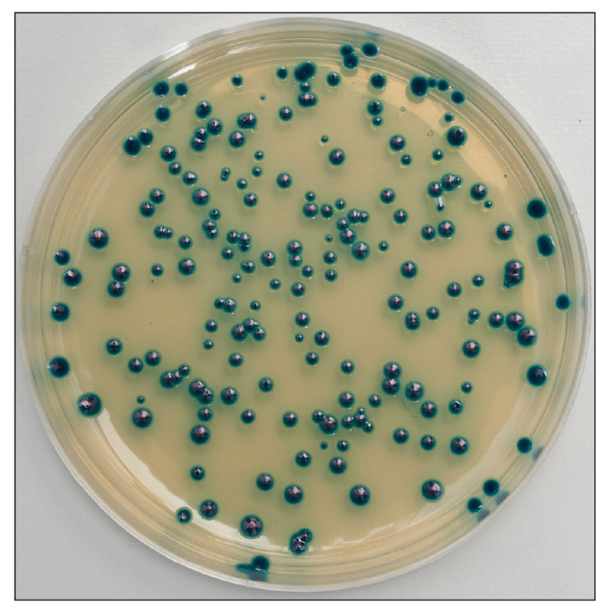
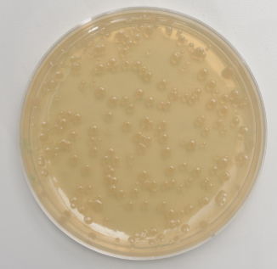
Introduction
Getting
Started
Bio-Rad’s Out of the Blue CRISPR Kit allows your students to do real Nobel prize-winning science. In this activity, students will edit the lacZ gene, a chromosomal gene that causes bacteria grown in the presence of x-gal to turn blue.
The experiment your students will perform is highly controlled. These controls allow your students to collect strong evidence that they have performed actual gene editing. Without these controls it is impossible to differentiate between a simple bacterial transformation and real CRISPR gene editing.
Use and modify the following slides to help your students understand Bio-Rad’s lacZ gene editing system and the experimental setup.

Slide 4
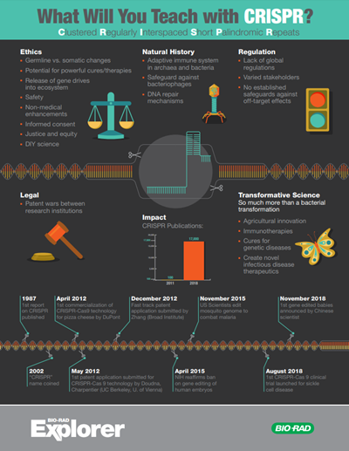
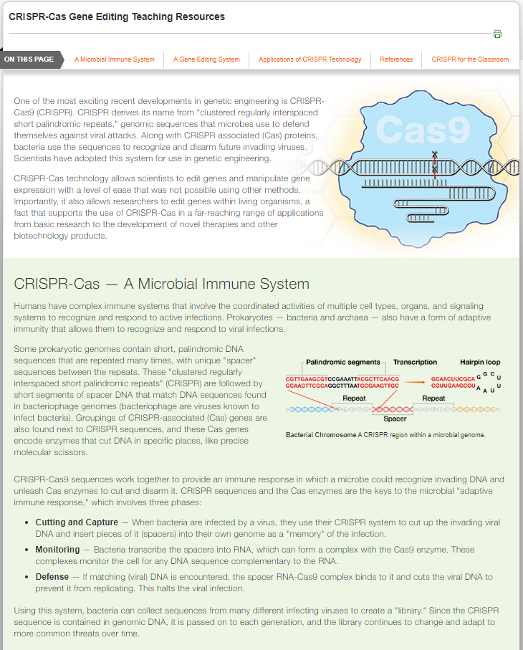
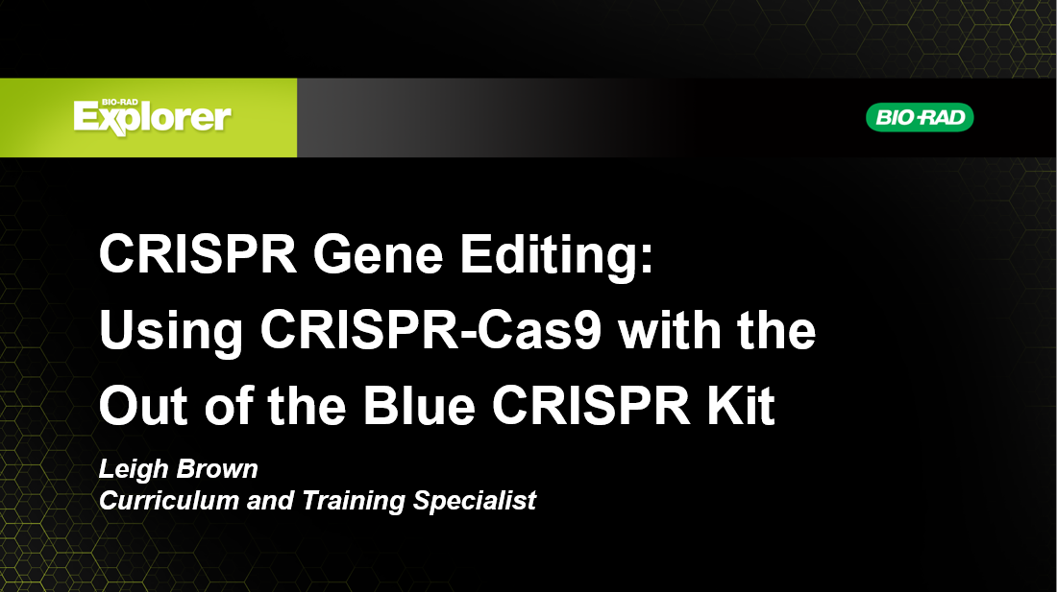
Additional Resources
Getting
Started
Visit bio-rad.com/teachcrispr for additional free classroom resources about CRISPR including science background and laboratory walkthrough videos.

Slide 5
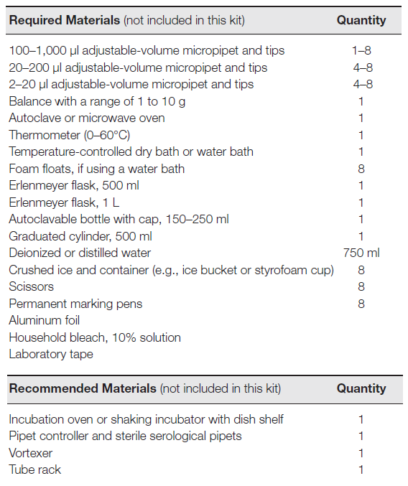
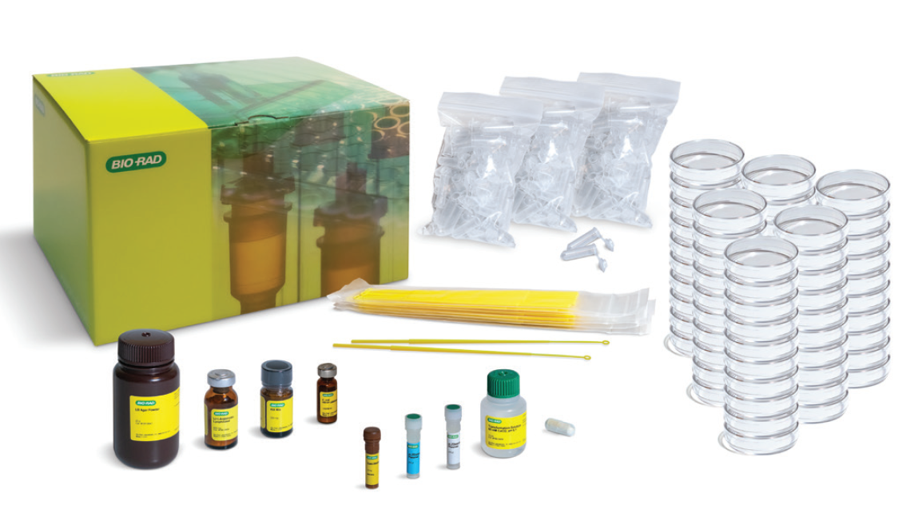
Required Materials
Instructor Preparation
Out of the Blue CRISPR Kit (12012608EDU)
Visit bio-rad.com/outoftheblue to download the instructor and student guides

Slide 6
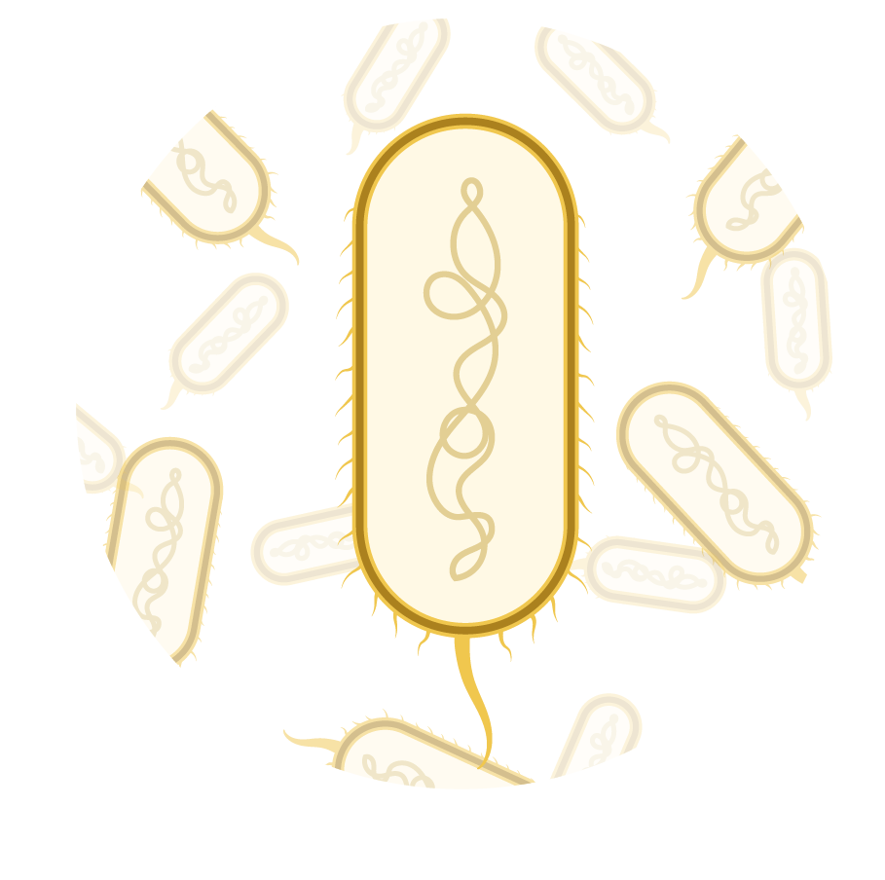
Wild type E. coli

Slide 7
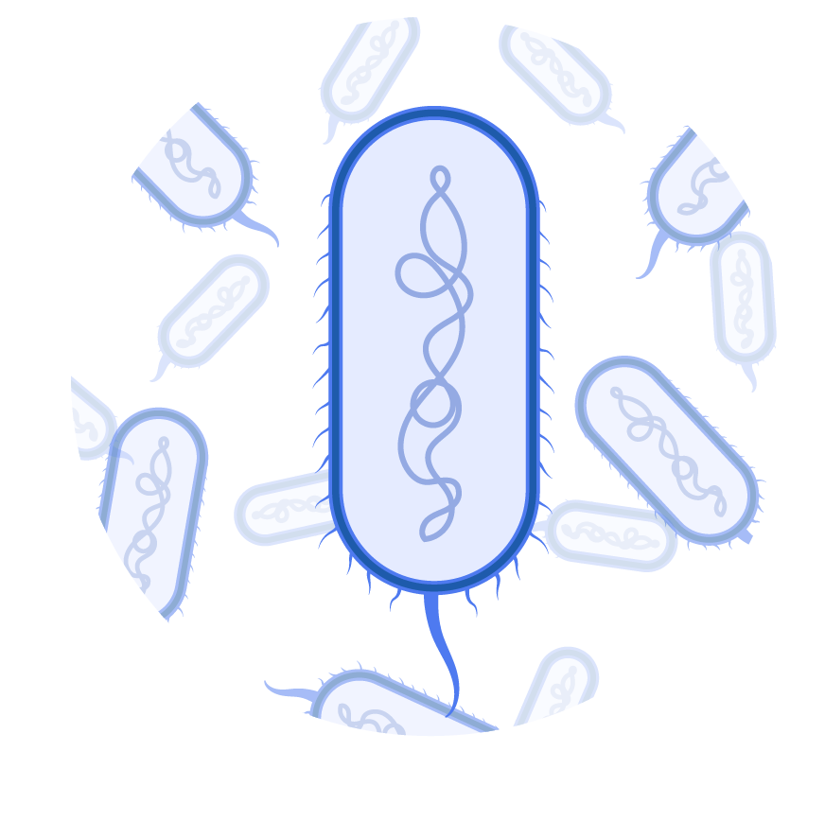
lacZ
β-gal
X-gal
Blue pigment

Slide 8
lacZ
β-gal
X-gal
Blue pigment

Slide 9
lacZ
lacZ

Slide 10
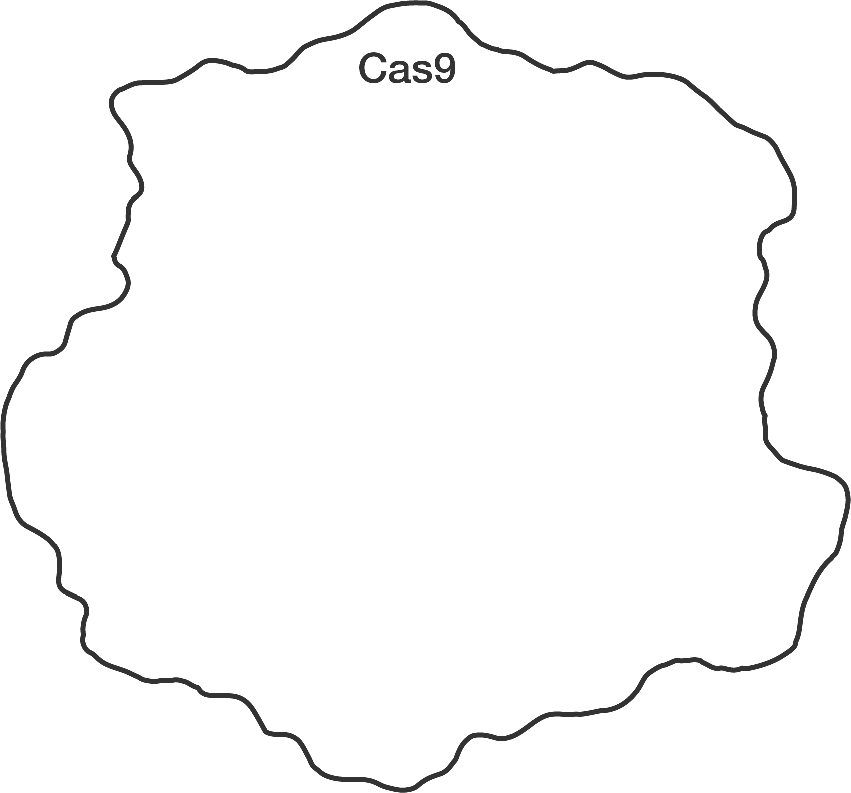
CRISPR-Cas9 Gene Editing
Cut
Repair
Cas9 protein

Slide 11
CRISPR-Cas9 Gene Editing
Cut
Repair
Single Guide RNA
(sgRNA)
Cas9-sgRNA complex

Slide 12
CRISPR-Cas9 Gene Editing
Cut
Repair
Target DNA

Slide 13
CRISPR-Cas9 Gene Editing
Cut
Repair
Cut site

Slide 14
CRISPR-Cas9 Gene Editing
Cut
Repair

Slide 15
Lethal Double-Stranded Breaks

Slide 16
CRISPR-Cas9 Gene Editing
Cut
Repair

Slide 17
CRISPR-Cas9 Gene Editing
Cut
Repair

Slide 18
CRISPR-Cas9 Gene Editing
Cut
Repair

Slide 19
CRISPR-Cas9 Gene Editing
Cut
Repair
Homology directed repair

Slide 20
CRISPR-Cas9 Gene Editing
Cut
Repair
Repair machinery
Homology directed repair

Slide 21
CRISPR-Cas9 Gene Editing
Cut
Repair
Repair machinery
Homology directed repair

Slide 22
CRISPR-Cas9 Gene Editing
Cut
Repair
3. Donor DNA
1. Cas9
4. Repair machinery
2. Guide RNA

Slide 23
CRISPR-Cas9 Gene Editing
Cut
Repair
lacZ
lacZ
Homology directed repair

Slide 24
CRISPR-Cas9 Gene Editing
Cut
Repair
STOP
lacZ
Stop codon
lacZ
STOP
Homology directed repair

Slide 25
CRISPR-Cas9 Gene Editing
Cut
Repair
3. Donor DNA
1. Cas9
4. Repair machinery
2. Guide RNA

Slide 27
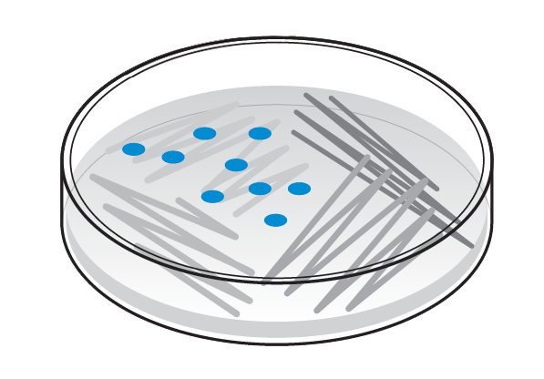
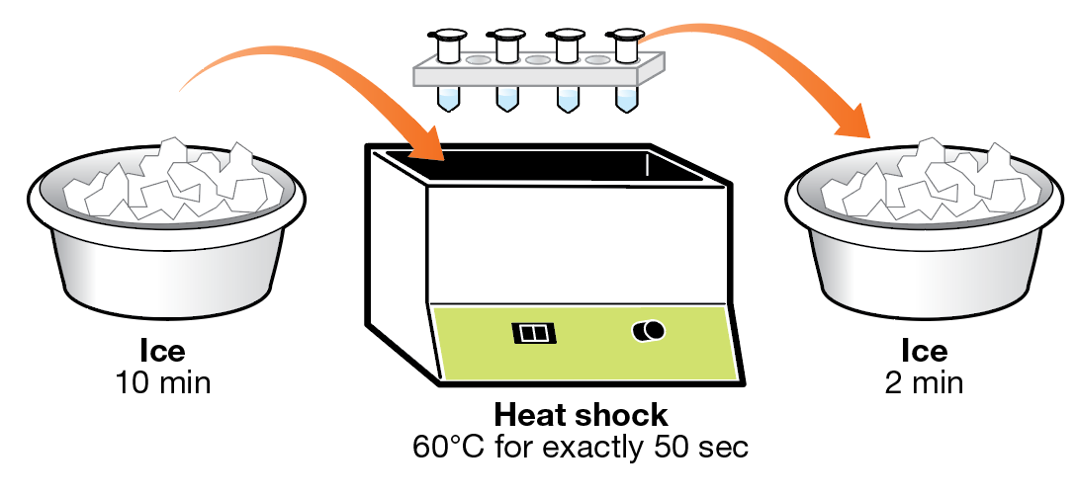
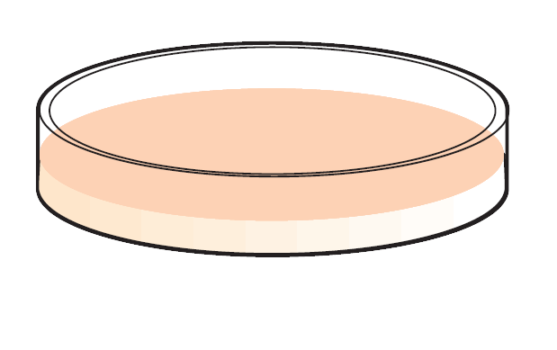
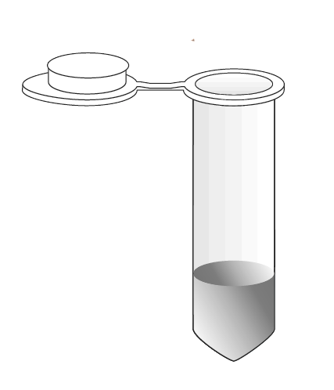
Protocol Overview
Starter plate bacteria
Plasmid

Slide 28
Cas9 expression

Slide 29
Arabinose Control of Repair Machinery
+ Arabinose
– Arabinose

Slide 30
Arabinose Control of Repair Machinery
Repair machinery ON
+ Arabinose
– Arabinose

Slide 31
Arabinose Control of Repair Machinery
Repair machinery ON
+ Arabinose
Repair machinery OFF
– Arabinose

Slide 32
Available Plasmids
Donor DNA
sgRNA
pLZDonorGuide
(pDG)
pLZDonor
(pD)

Slide 33
Source | Component
Cut
Repair
Starter plate
pDG plasmid

Slide 34
Experimental setup
+ Donor DNA
+ sgRNA
+ Donor DNA
+ Repair machinery
– Repair machinery

Slide 35
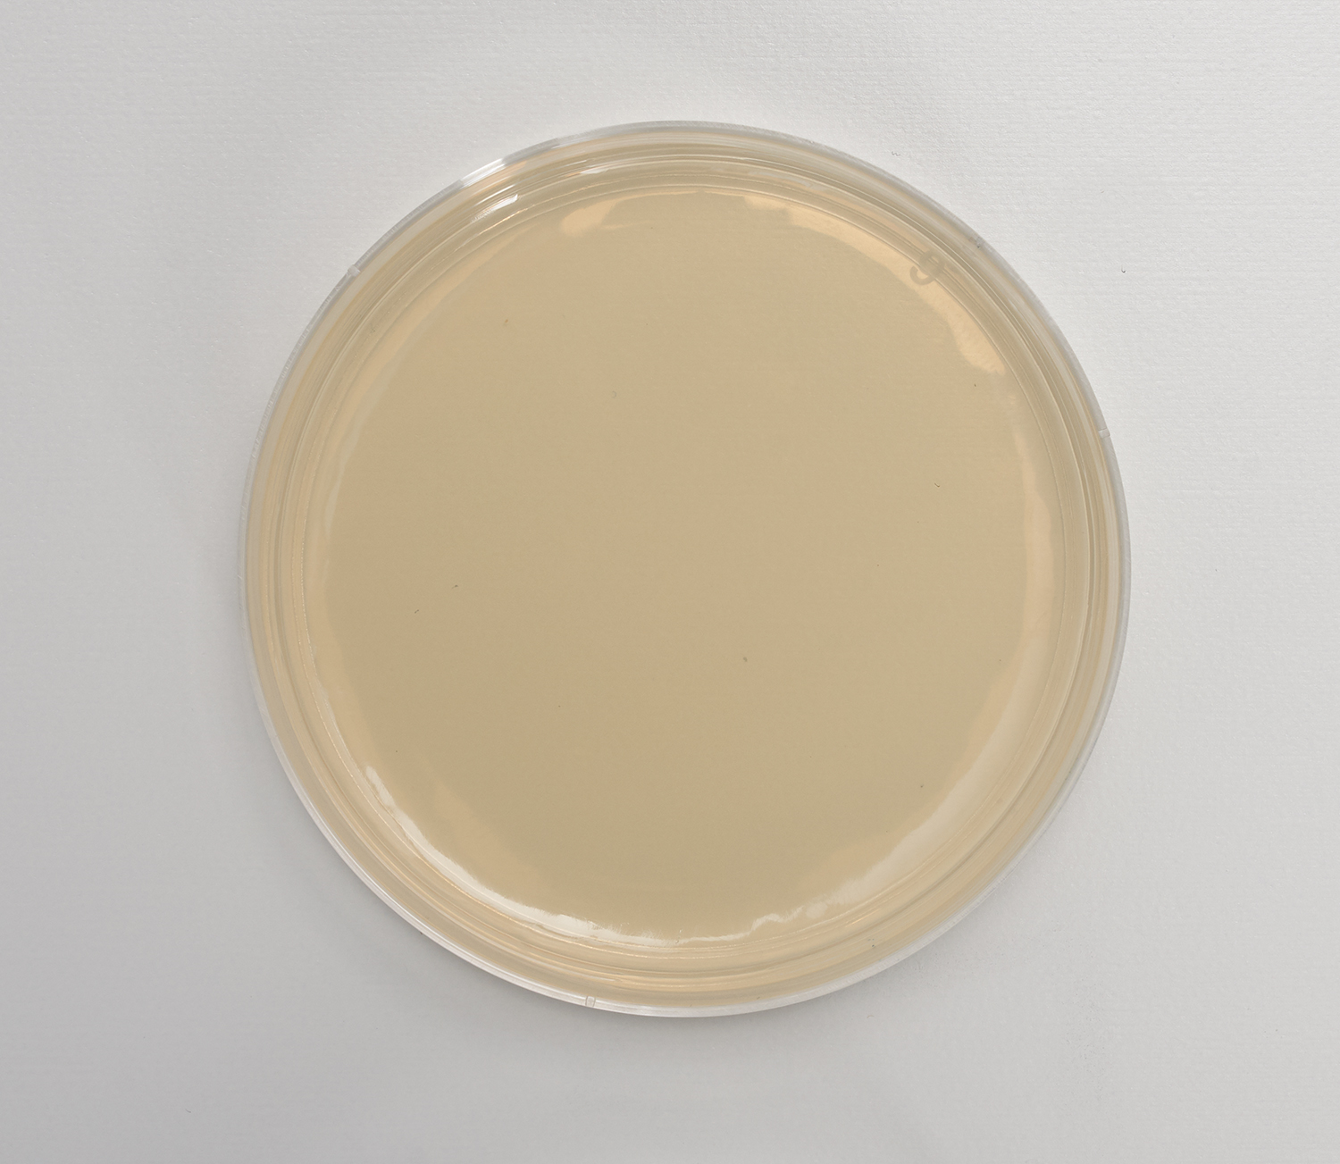
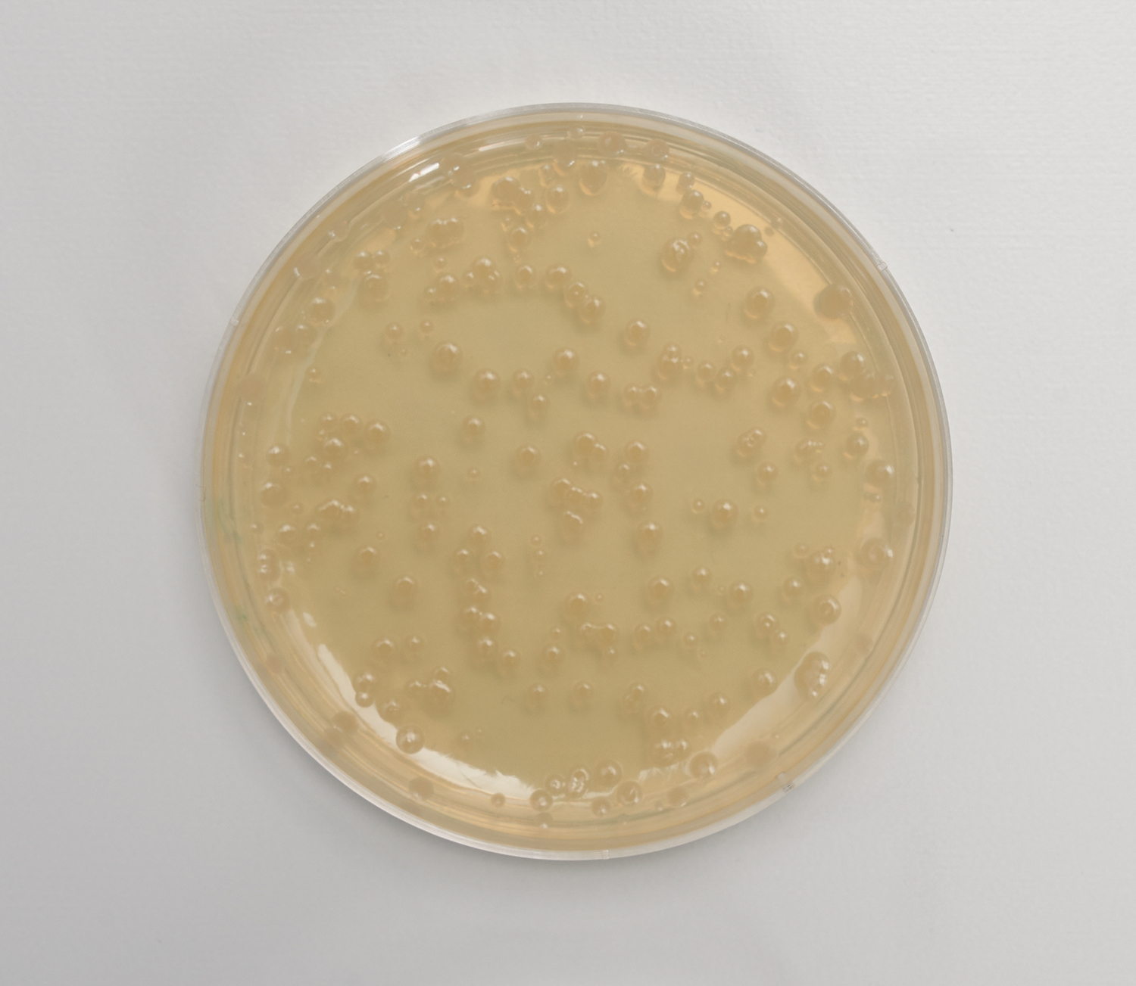
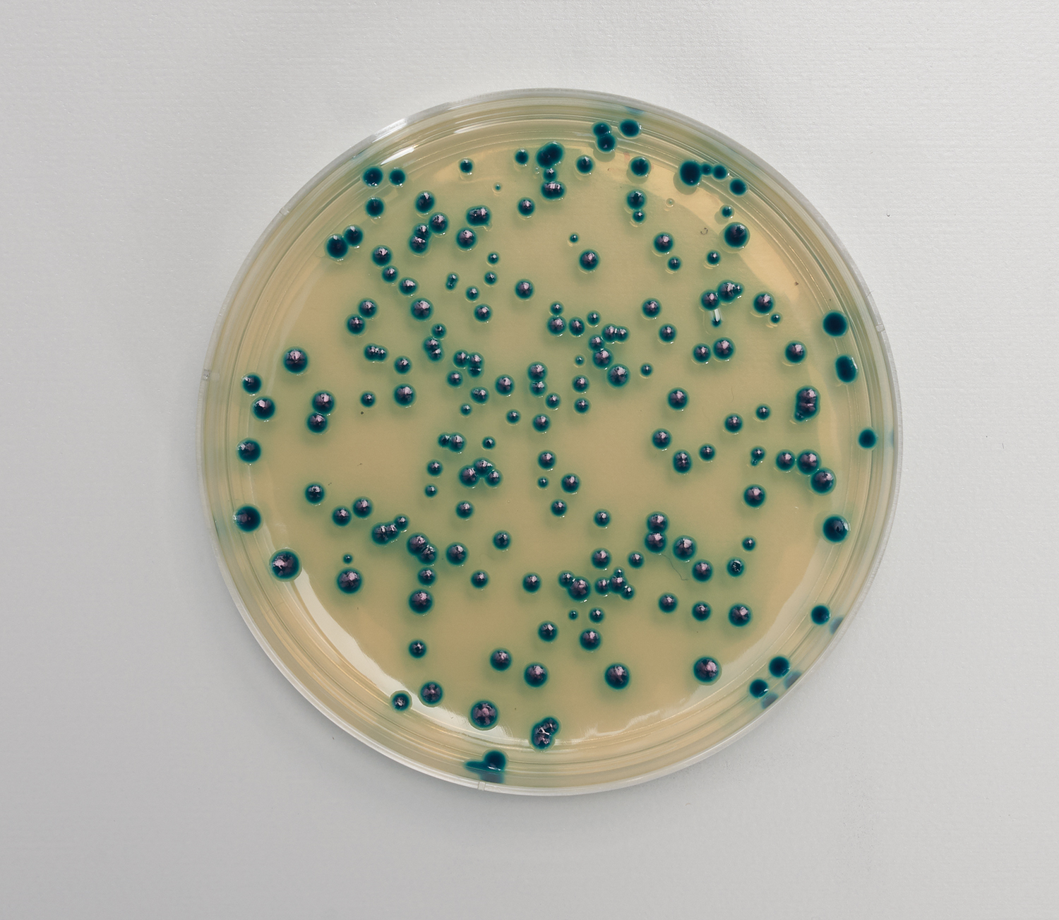
Example Results

Slide 36
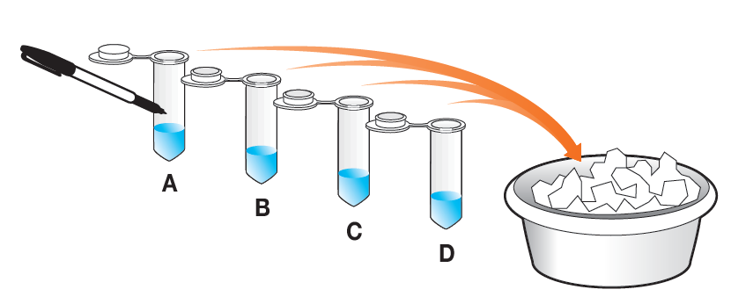

Slide 37
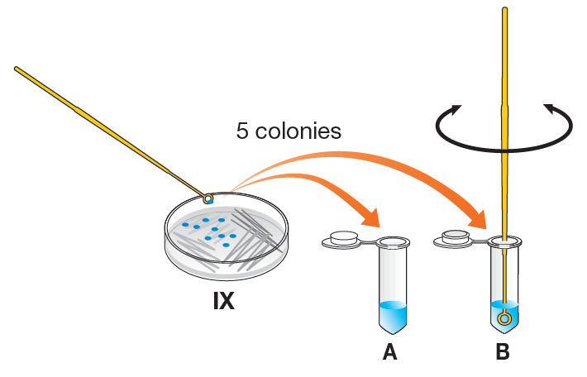

Slide 38
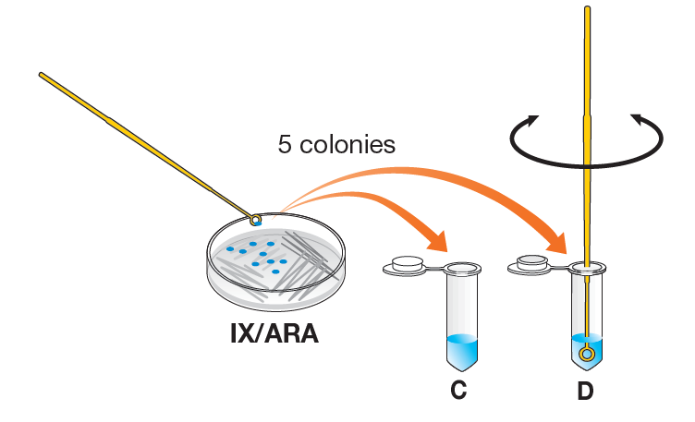

Slide 39
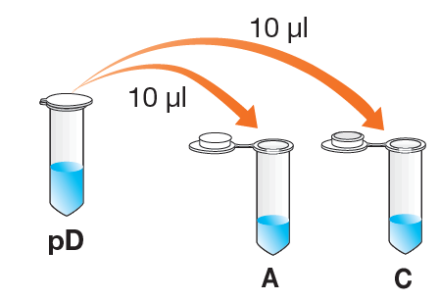
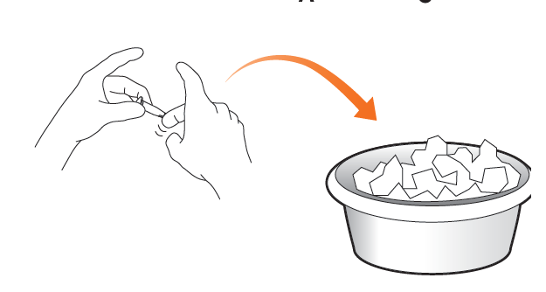

Slide 40
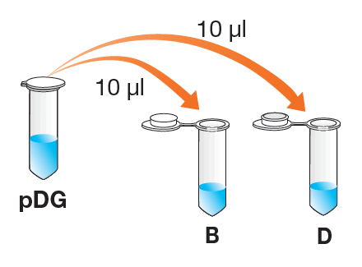

Slide 41
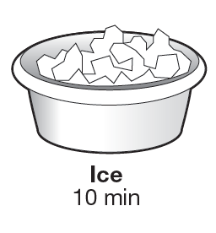

Slide 43
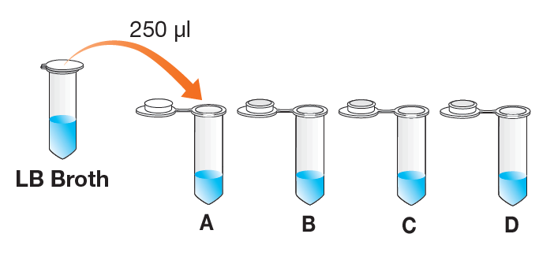

Slide 45
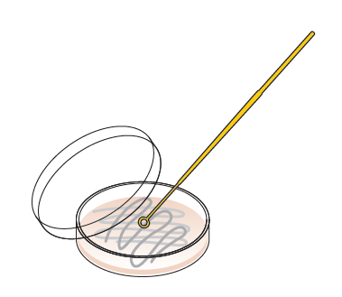
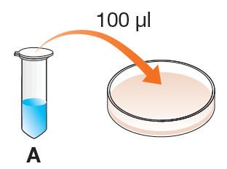

Slide 46
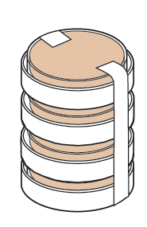

Slide 47
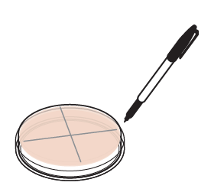

Slide 48
Example Results

