Slide 1
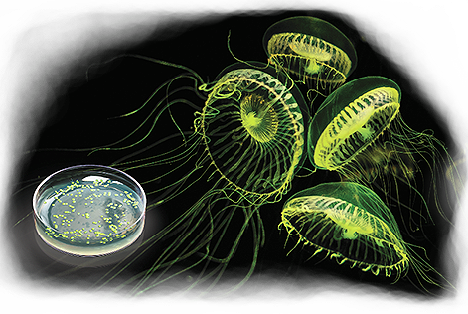
pGLO Bacterial Transformation
Student presentation for use with the pGLO Transformation and Inquiry Kit for AP Biology
BIO-RAD is a trademark of Bio-Rad Laboratories, Inc. in certain jurisdictions. All trademarks used herein are the property of their respective owner.
© 2020 Bio-Rad Laboratories, Inc.

Slide 2
Contents
Getting
Started
Getting Started
Instructor Preparation
Student Slides
Introduction
Additional Resources
Required Materials
Background information
Protocol steps

Slide 3
Introduction
Getting
Started
Bio-Rad’s pGLO Transformation and Inquiry Kit for AP Biology enables hands-on learning of the central dogma, gene expression and regulation, bacterial transformation, protein separation, and the biomanufacturing process — with glowing bacteria!
This presentation is designed to be used with Laboratory
Use and modify this slide deck with your students as needed.
A printed copy of the Instructor Guide can be found inside for free from the pGLO Bacterial Transformation Kit product webpage.

Slide 4
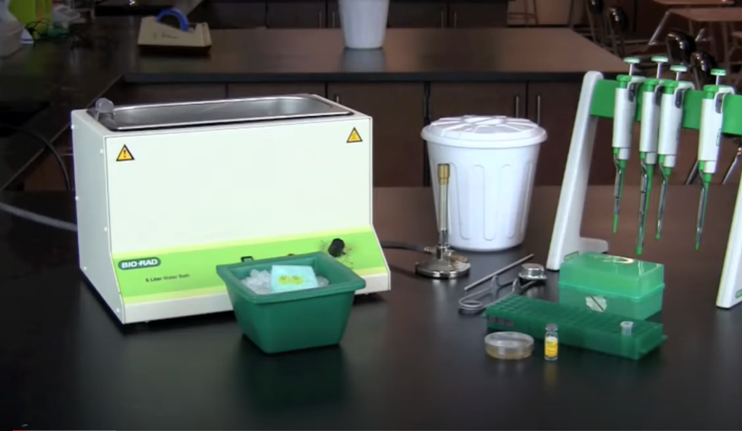
Additional Resources
Getting
Started
Visit bio-rad.com/teachpglo for more background information about the pGLO system. Visit bio-rad.com/pglovideos to view Bio-Rad’s collection of tutorial videos and get glowing faster!
pGLO Bacterial Transformation Tutorial Videos
pGLO Teaching Resources

Slide 5
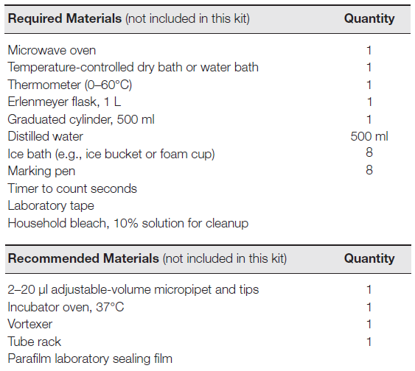
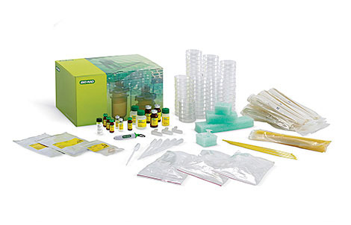
Required Materials
Instructor Preparation
pGLO Transformation and Inquiry Kit for AP Biology (1660335EDU)

Slide 6
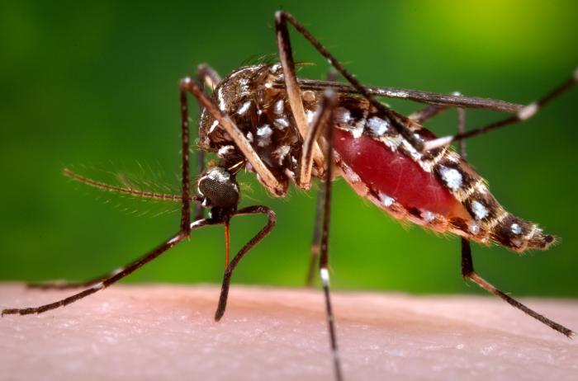
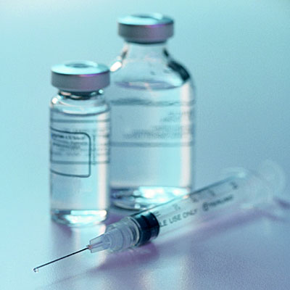
Why genetically modify organisms?
Modified animal models for research
Cancer, obesity, heart disease, etc.
Modified mosquitoes to fight disease
Drug production like insulin, hormones, vaccines, and anti-cancer drugs.
Disease/drought/pest resistance.
Increased nutrition

Slide 7
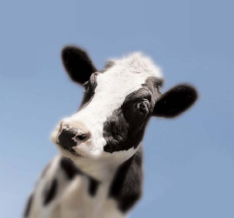
Brief history of insulin
1922 – Canadian researchers isolate insulin, cure diabetics using bovine insulin, and win the Nobel Prize in 1923. Previously, diabetes had been a virtual death sentence – there was no treatment.
1978 – scientists at Genentech produce human insulin using genetically engineered E. coli (recombinant DNA, or rDNA).
1982 – Humulin approved by the FDA.

Slide 8
The protein products of biotech
 | Used to treat | Made in | Price per gram
Gold | N/A | N/A | $40
Insulin | Diabetes | E. coli | $60
Human Growth Hormone | Growth disorders | E. coli | $227,000
Granulocyte Colony Stimulating Factor | Cancers | E. coli | $1,357,000

Slide 9
How can we make LOTS of protein?
Identify a gene for a protein.
Gene

Slide 10
How can we make LOTS of protein?
Identify a gene for a protein.
Put the gene into bacteria.
E. coli

Slide 11
How can we make LOTS of protein?
Identify a gene for a protein.
Put the gene into bacteria.
Grow lots of the bacteria.

Slide 12
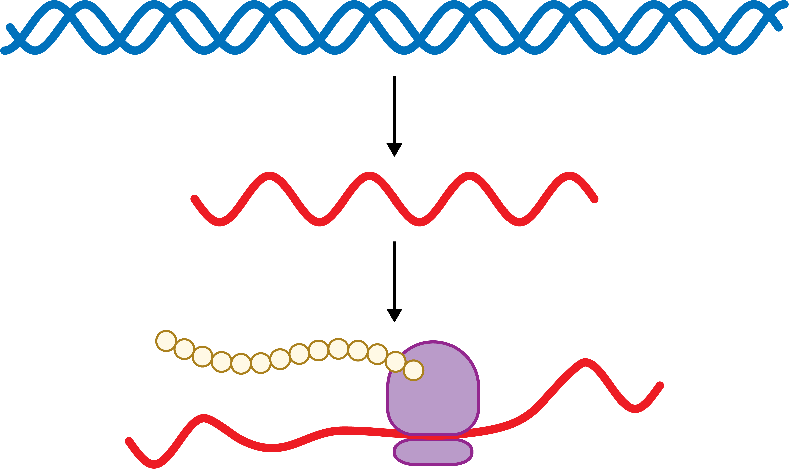
How can we make LOTS of protein?
Identify a gene for a protein.
Put the gene into bacteria.
Grow lots of the bacteria.
The bacteria transcribe and translate the gene — mini protein factories!
DNA
mRNA
protein

Slide 13
How can we make LOTS of protein?
Identify a gene for a protein.
Put the gene into bacteria.
Grow lots of the bacteria.
The bacteria transcribe and translate the gene — mini protein factories!

Slide 14
How can we make LOTS of protein?
Identify a gene for a protein.
Put the gene into bacteria.
Grow lots of the bacteria.
The bacteria transcribe and translate the gene — mini protein factories!
Purify the protein.

Slide 15
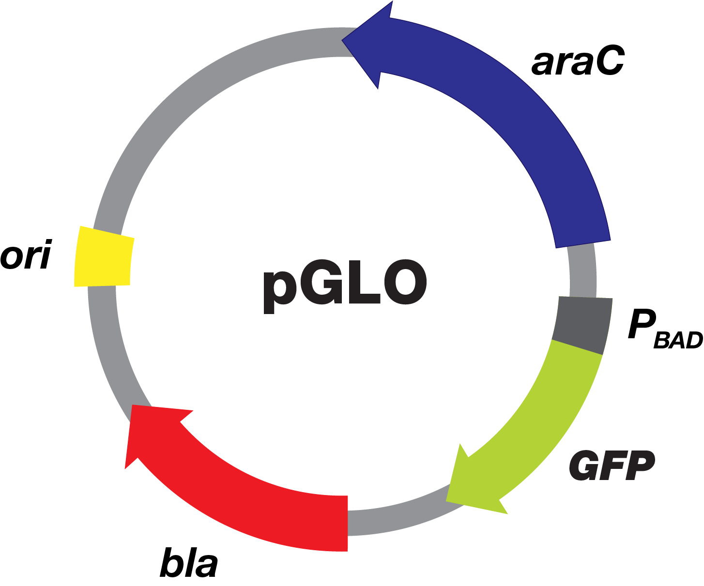
How do you get genes into bacteria?
Make a plasmid with your gene.
Do bacterial transformation. This is what you’ll do in this activity.
Plasmid
E. coli

Slide 16
Genetic engineering using plasmids
Bacteria often have plasmids — circular loops of DNA
Chromosome
Bacteria
Plasmids

Slide 17
Genetic engineering using plasmids
Scientists and modify or engineer plasmids for specific purposes.
Origin of replication Let’s the bacteria make copies of the plasmid
Genes of interest Genes for protein production or other desired trait
Antibiotic resistance Allows transformed bacteria to survive on plates with antibiotic

Slide 18
Green fluorescent protein
The jellyfish Aequorea Victoria has a gene for green fluorescent protein which glows green under UV light.
Under visible light
Under ultraviolet (UV) light

Slide 19
pGLO plasmid
The pGLO plasmid is engineered to have the GFP gene from Aequorea victoria.
araC Gene for the protein AraC that controls the GFP gene like and ON/OFF switch.
ori
pGLO
Beta-lactamase Allows transformed bacteria to survive on plates with ampicillin
GFP Gene for green fluorescent protein.

Slide 20
pGLO plasmid DNA

Slide 21
Bacterial Membrane
E. coli
Plasma Membrane
Non-polar
Polar

Slide 22
Add plasmid
Plasmid DNA
E. coli
Plasma Membrane

Slide 23
Add plasmid
Negative charges on DNA backbone
E. coli

Slide 24
Add transformation solution (CaCl₂)
E. coli
Ca²⁺ shields charges on DNA to make it less polar

Slide 25
Heat Shock
E. coli
Add heat to create pores in the membrane

Slide 26
Heat Shock
E. coli
Add heat to create pores in the membrane

Slide 27
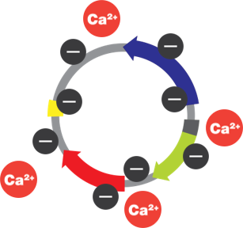
Heat Shock
Plasmid enters cell through pore
E. coli

Slide 28
Recovery on ice, 2 min
Pores close
E. coli

Slide 29
Add LB broth, allow gene expression, 10 min
E. coli

Slide 30
Add LB broth, allow gene expression, 10 min
AraC, regulatory protein
E. coli
Beta-lactamase, ampicillin resistance
GFP, only if arabinose is in the media

Slide 31
Selective media – ampicillin

Slide 32
Selective media – ampicillin
Beta-lactamase, ampicillin resistance

Slide 33
Selective media – ampicillin
Ampicillin on the plate
Bacteria without the plasmid cannot grow in the presence of ampicillin

Slide 34
Selective media – ampicillin
Transformed bacteria (with the plasmid) will make beta-lactamase , which breaks down ampicillin. This enables them to grow on ampicillin plates
Bacteria without the plasmid (NOT transformed) cannot grow on plates with ampicillin.

Slide 35
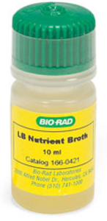
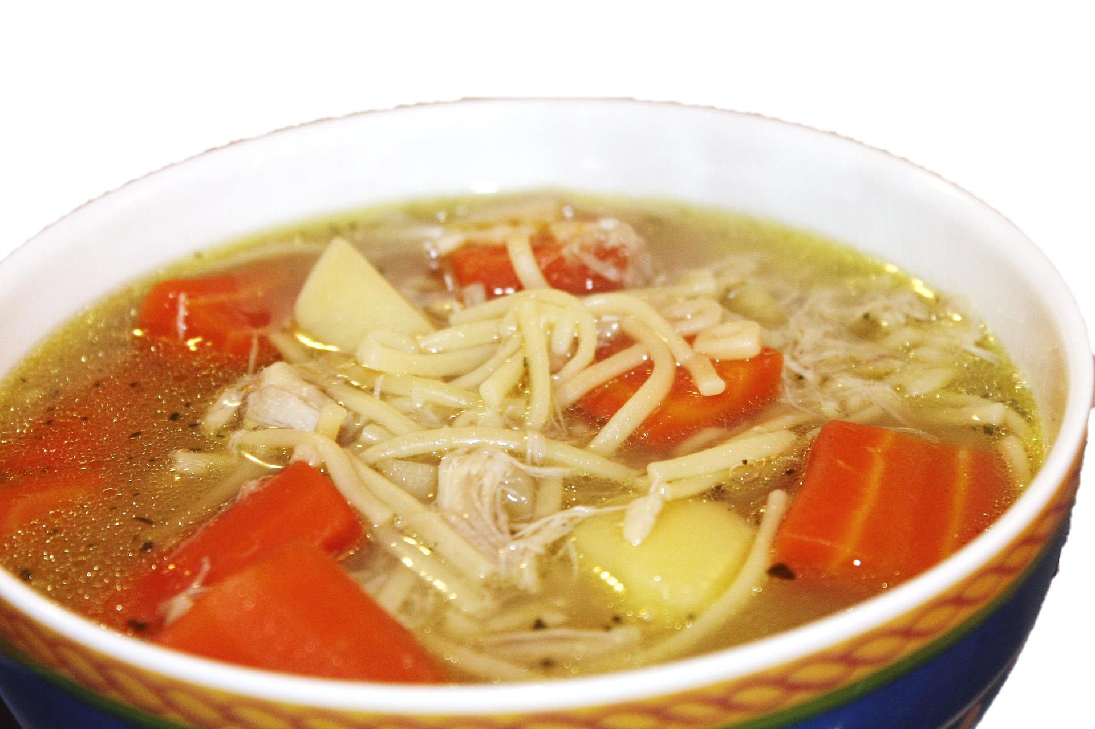
LB Broth
LB (Lysogeny broth or Luria Bertani) broth is like chicken noodle soup for bacteria. It has all the nutrients bacteria need to grow:
Carbohydrates
Amino acids
Nucleotides
Salts
Vitamins

Slide 36
Transformation summary
1. | CaCl₂ transformation solution | Shields negative charge on DNA.
2. | Pre-heat shock incubation on ice | Slows fluid plasma membrane for greater shock.
3. | Heat shock | Increases permeability of cell membranes.
4. | Post-heat shock incubation on ice | Restores cell membrane.
5. | Incubation at room temperature with LB broth | Allows beta-lactamase expression so bacteria can grow on plates with ampicillin.
6. | Spread on LB/amp plates | Selects for transformed bacteria and allows formation of colonies.

Slide 37
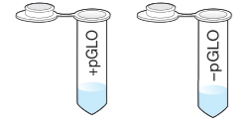
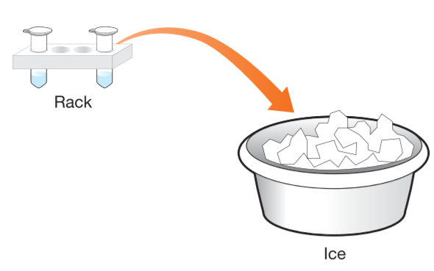
Label tubes
You have tubes with 250 µl transformation solution.
Label one +pGLO and the other –pGLO.
Add your initials.
Place into foam rack and on ice.

Slide 38
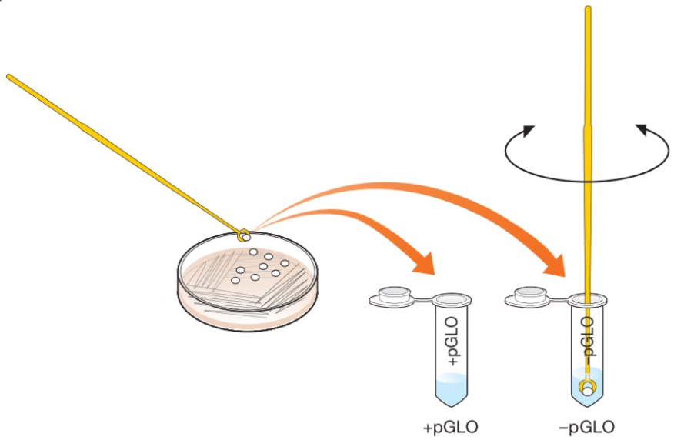
Pick colonies
Using a sterile loop pick 1–2 large E. coli colonies.
Add to the +pGLO tube. Spin the loop to disperse the bacteria. No clumps!
Using a new loop, at 1–2 colonies to –pGLO tube.
Place tubes into foam rack and on ice.

Slide 39
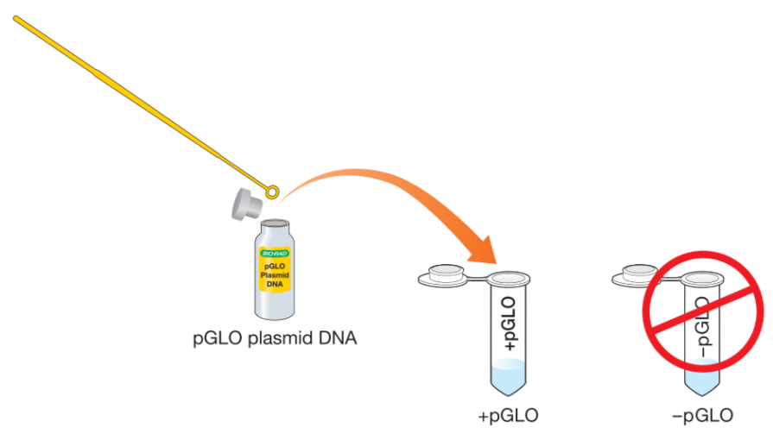
Add plasmid DNA
Add 10 µl (1 loop full) pGLO plasmid to +pGLO tube. DO NOT ADD TO –pGLO tube.
Place tubes into foam rack and on ice for 10 min.
10 min

Slide 40
Label plates
While your tubes are on ice, label the bottom of your plates.
Add your group ID or initials.
LB
–pGLO
LB/amp
–pGLO
LB/amp
+pGLO
LB/amp/ara
+pGLO

Slide 41
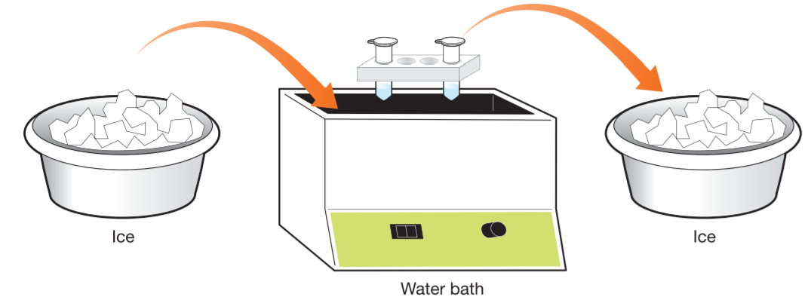
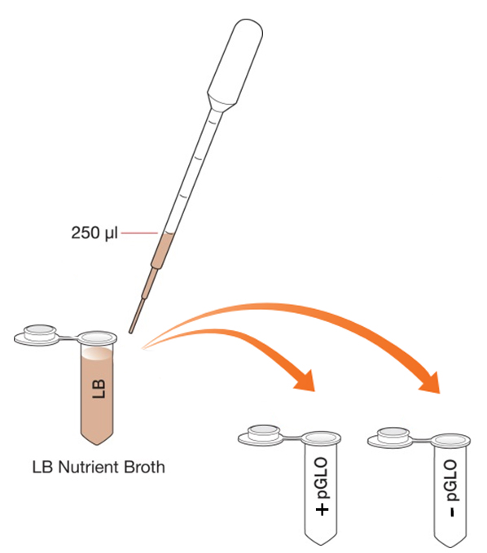
Heat shock
Get your timers ready!
Heat shock tubes at 42°C for exactly 50 sec.
Immediately return tubes to ice for 2 min.
Add 250 µl LB broth to both tubes.
Leave at room temperature for 10 min.

Slide 42
Meanwhile…
E. coli

Slide 43
Plasmid genes are expressed
E. coli

Slide 44
Beta-lactamase
E. coli
Beta-lactamase, ampicillin resistance

Slide 45
Beta-lactamase makes E. coli resistant to ampicillin
Transformed bacteria (with the plasmid) will make beta-lactamase , which breaks down ampicillin . This enables them to grow on ampicillin plates
Bacteria without the plasmid (NOT transformed) cannot grow on plates with ampicillin.

Slide 46
AraC
AraC, regulatory protein
E. coli

Slide 47
AraC Controls Expression of GFP
Arabinose (a sugar) works like a switch.
AraC
Without arabinose, the switch is OFF. AraC blocks RNA polymerase , and the GFP gene is not transcribed.
RNA polymerase
With arabinose , the switch is ON. AraC changes shape and RNA transcribes the GFP gene.

Slide 48
Green Fluorescent Protein (GFP)
E. coli
GFP, only if arabinose is in the media

Slide 49
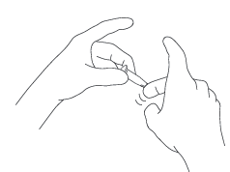
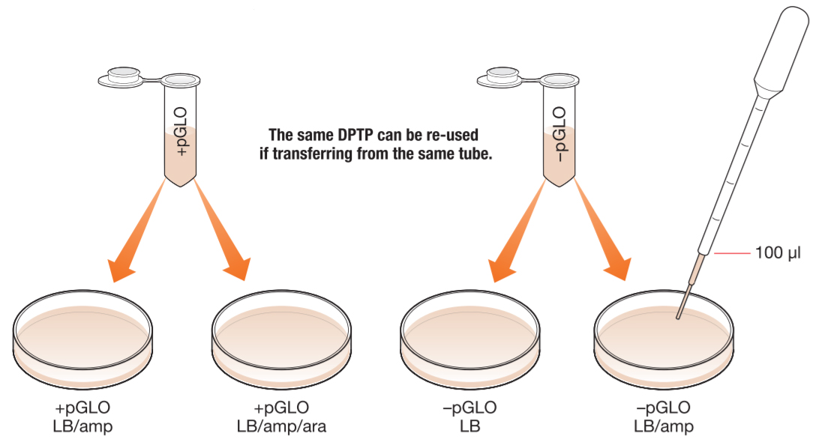
Plating Bacteria
Flick tubes to mix.
Using a new sterile pipet, add 100 µl bacteria to appropriate plates (+pGLO or –pGLO).
Use a loop to spread bacteria evenly. Use a new loop for each plate.
Incubate overnight at 37°C or for 2 days at room temperature.

Slide 50
 |  | Plates
 |  | –pGLO LB | –pGLO LB/amp | +pGLO LB/amp | +pGLO LB/amp/ara
Components | Bacteria
 | DNA
 | Ampicillin
 | Arabinose
 | Grow?
 | Glow?
Notes:
Duplicate the green check mark icon to fill out this table with your students.

Slide 51
Transformation Efficiency
How successful was your transformation? You can calculate the transformation efficiency and compare with other groups.
87 colonies growing on plate
= 543 transformants/μg
Example
0.16 μg of DNA spread
(or 5.4 x 10² transformants/μg)

Slide 52
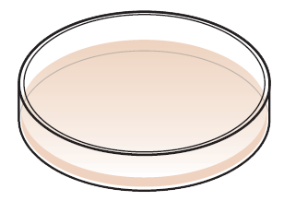
Extra graphics

