Slide 1
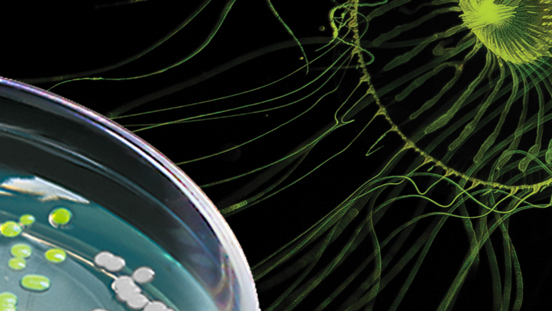
pGLO Bacterial Transformation for General Biology
Background and Student Protocol
BIO-RAD is a trademark of Bio-Rad Laboratories, Inc. All trademarks used herein are the property of their respective owner.
© 2023 Bio-Rad Laboratories, Inc.

Slide 2
Slide Deck Overview
Background
Information
Student Activity
or Lab Protocol
Results and Troubleshooting
Tips & Notes

Slide 3
Notes to instructor:
This is your copy of this slide deck. Modify it however you’d like.
The font used is Arial Nova Light – you can download it free from Microsoft.
Some of the background information is up front (before the lab protocol). Some of it is covered during the lab protocol. Background slides have green lines at the top, and protocol or activity slides have orange lines. Rearrange the slides to suit your needs.
View the slides in presentation mode – some have animations that will not appear in the “normal” view (edit mode).
The notes section has links and information from the Bio-Rad Biotechnology textbook and/or Bio-Rad kit manuals.
Please contact us at explorer@bio-rad.com with any questions, suggestions, or comments. Enjoy!

Slide 4
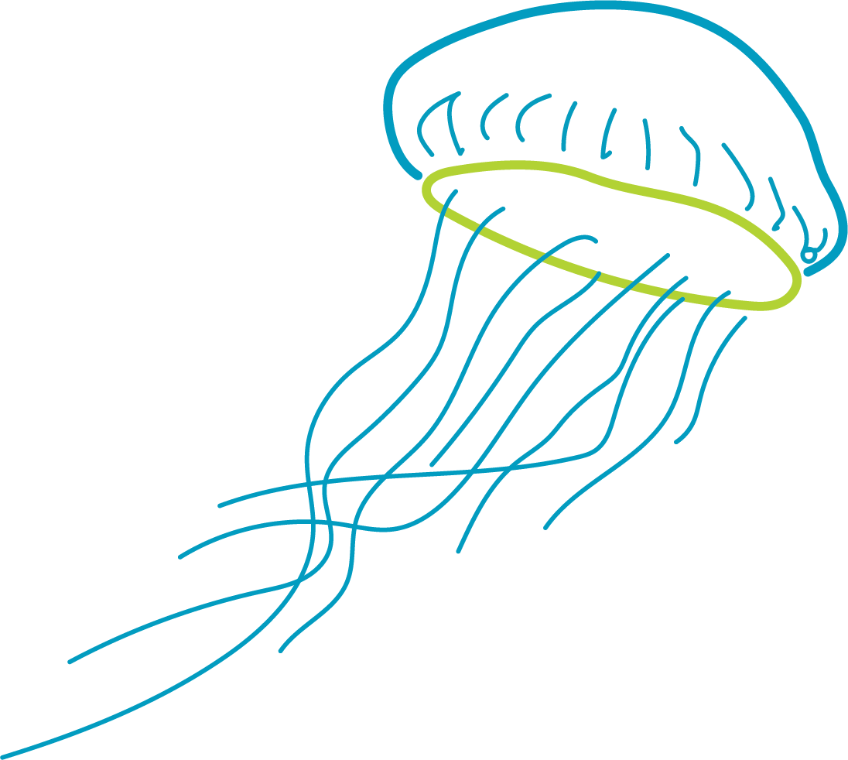
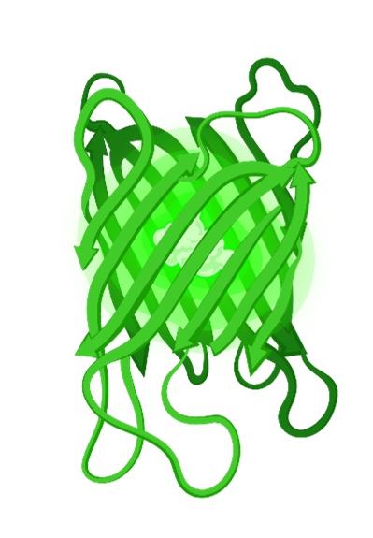
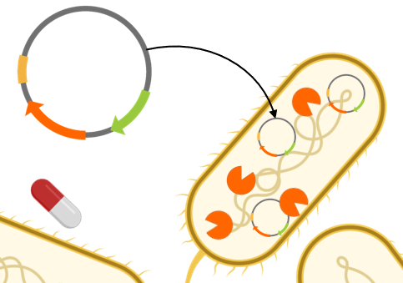
Background Information
Genetic engineering, GFP, plasmids, bacterial transformation, and selection
Notes:
Images created in BioRender

Slide 5
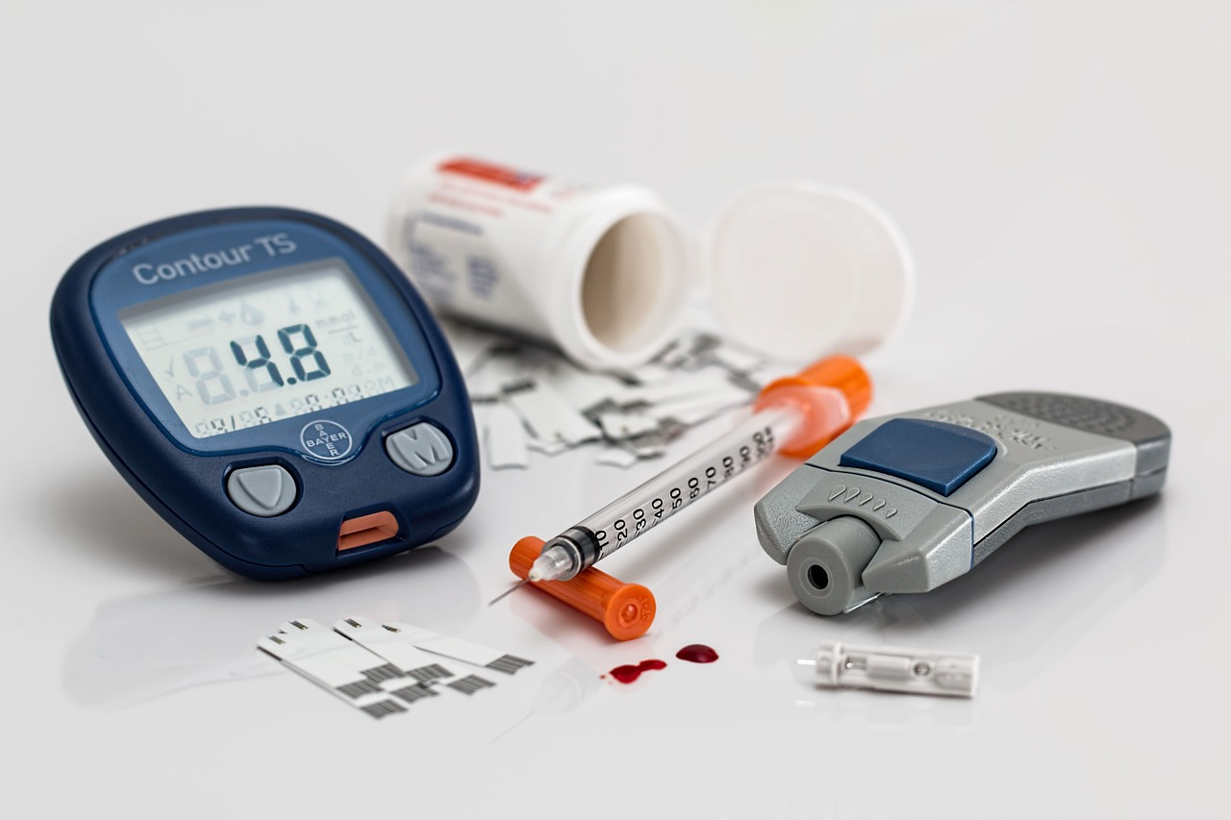
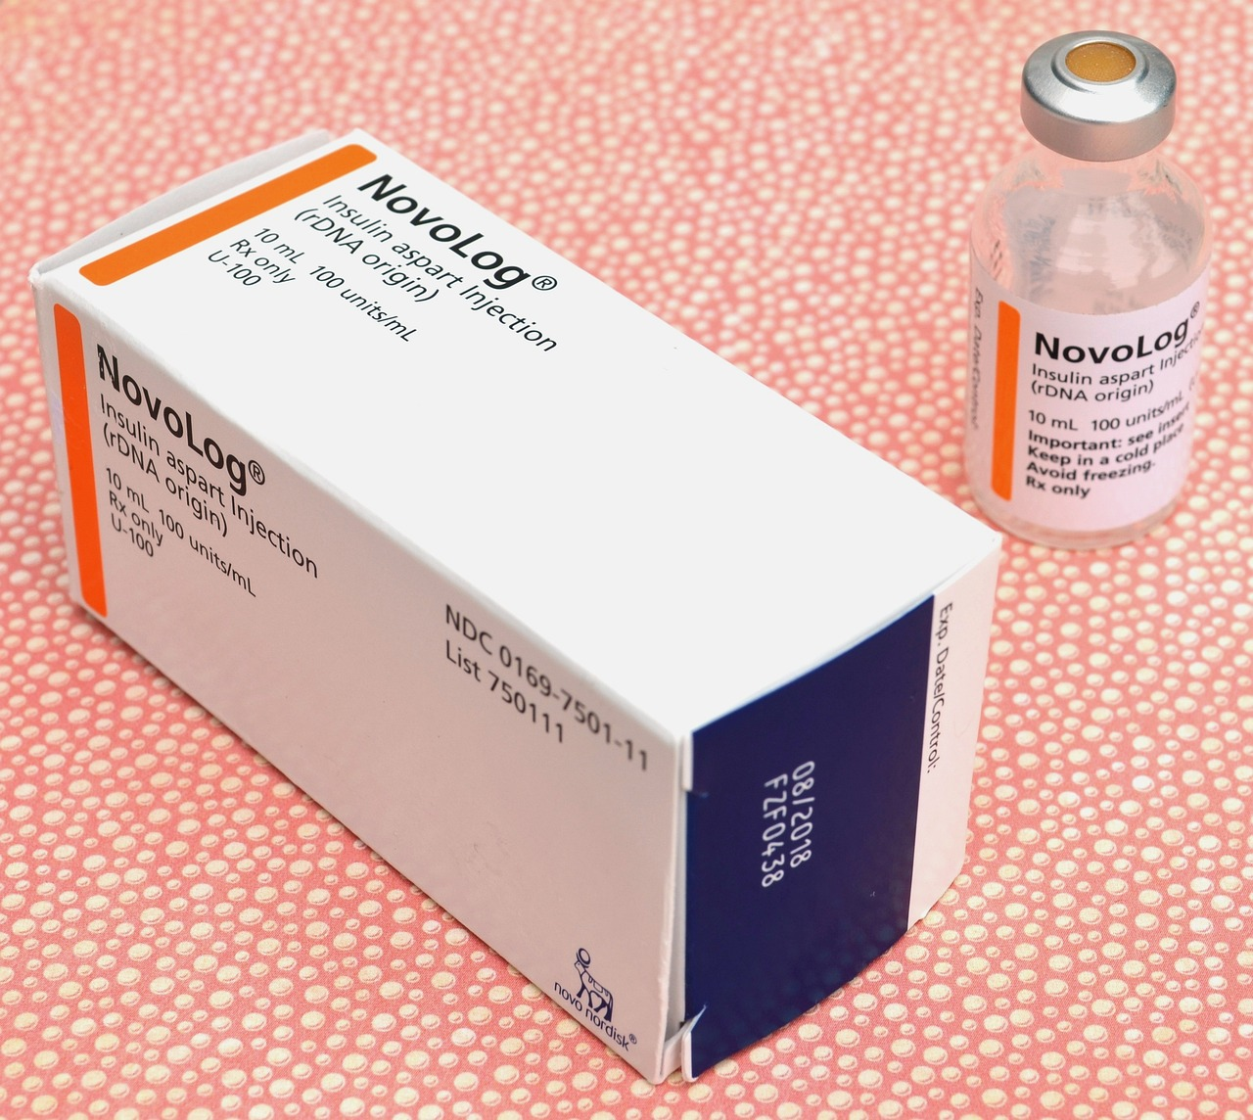
Setting the stage
Notes:
Ask students:
“ How many of you know someone with diabetes?”
“What do diabetics (type 1) take to regulate their blood sugar?”
- insulin
“Where does this insulin come from?”
-from a biotech company or an animal
“Where did insulin come from before making it in bacteria?”
= pancreas harvested from slaughtered pigs or cows
“Why would pig and cow insulin not be the best insulin?”
= 1 amino acid different than human, so problems with efficacy and immune reactions
= takes a long time and resources to grow a pig and cow

Slide 6
Insulin timeline
First patient (14 years old) is treated with insulin
Previously, diabetes was a death sentence – there was no treatment or cure
Insulin from cow and pig pancreas continues to be used for decades
1921
1923
1978
1922
1930s-1970s
Frederick Banting figures out how to remove insulin from a dog’s pancreas
John Macleod refines insulin from cow pancreas
Eli Lilly begins production of commercial insulin
Banting and Macleod
receive Nobel Prize
First genetically engineered synthetic human insulin produced in E. coli at Genentech
Humulin brought to market by Eli Lilly in 1982
Notes:
(Animated slide)
https://diabetes.org/blog/history-wonderful-thing-we-call-insulin
(Animated slide)

Slide 7
Cost per gram
Gold
$63
Insulin
$8800
Granulocyte Colony Stimulating Factor $1 million+
Human Growth Hormone $580,000
Notes:
Proteins are the products of biotech!
0.0347mg of insulin per unit
Cost of insulin = $0.30 per unit (2023 prices)
$0.30 / 1 unit x 1 unit / .000034 g = $8800
Human Growth Hormone
$7000 / 12 mg x 1 mg / .001 g = $580,000
Neulasta (Pegfilgrastim / G-CSF)
$6418 / 6 mg dose x 1 mg / .001g = $1 million +

Slide 8
Other Recombinant Drugs
 | Drug (Brand) | Molecule / Mechanism | Indications | Cell Factory
 | Filgrastim (Neupogen) | Cytokine — stimulates growth of white blood cells | Acute lymphocytic leukemia | E. coli
 | Interferon alfa-2a | Recombinant interferon - antiviral | AIDS-related Kaposi’s sarcoma, chronic hepatitis C, leukemia | E. coli
 | Hepatitis B Vaccine (Recombivax) | Subunit viral vaccine from HBsAG | Hepatitis B | S. cerevisiae
 | Trastuzumab (Herceptin) | Recombinant human monoclonal antibody | Breast cancer, stomach cancer | CHO
 | Etanercept (Enbrel) | Recombinant soluble fusion protein — TNF inhibitor | Rheumatoid arthritis | CHO
 | Adalimumab (Humira) | Recombinant human monoclonal antibody | Arthritis, plaque psoriasis, Crohn's disease, ulcerative colitis | CHO
Notes:
https://www.ncbi.nlm.nih.gov/pmc/articles/PMC4748523/

Slide 9
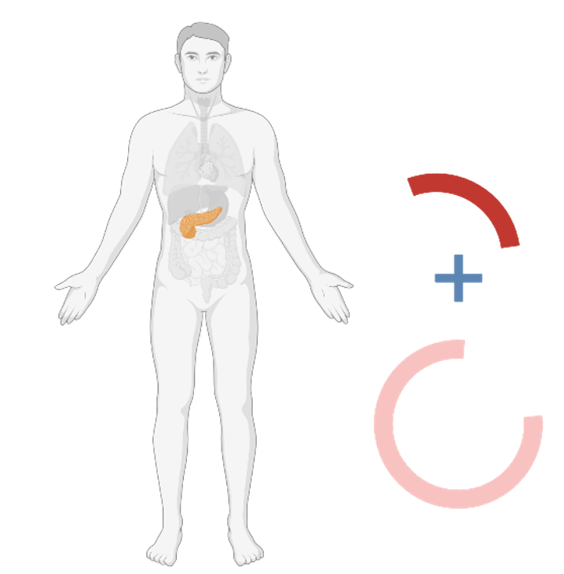
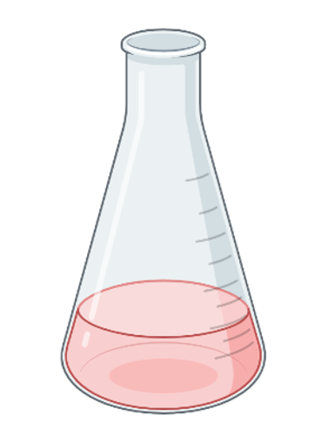
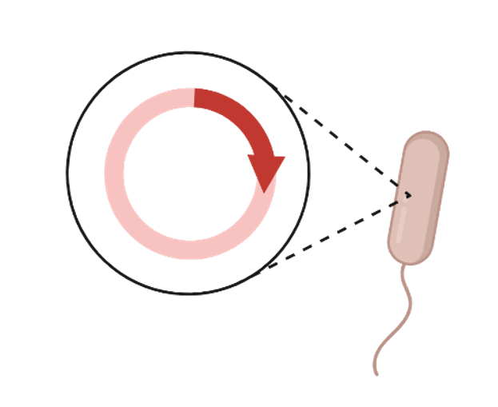
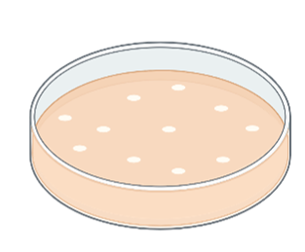
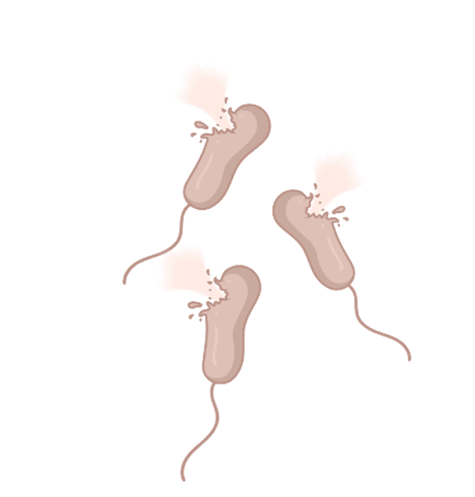
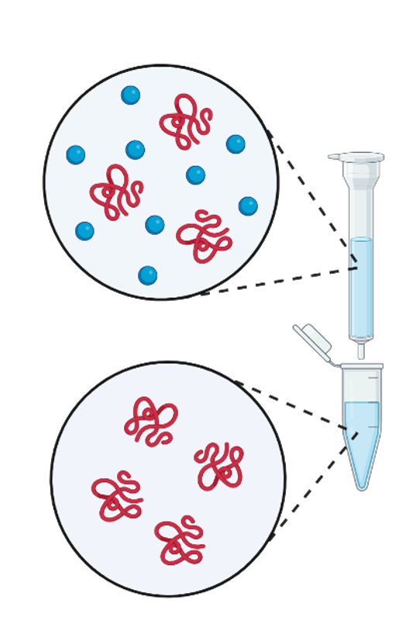
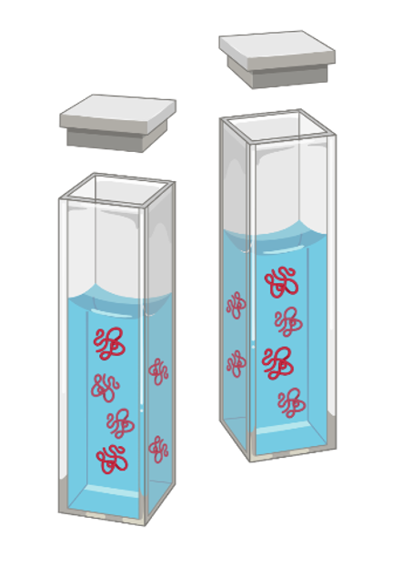
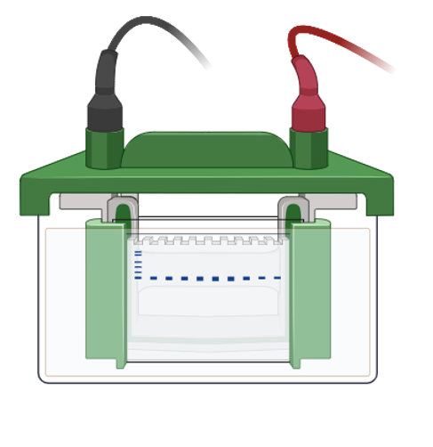
How do we produce drugs like insulin?
1
Clone human insulin gene into plasmid
2
Transform bacteria with plasmid
3
Select transformed
bacteria
4
Culture bacteria and
induce gene expression
5
Lyse cells
6
Purify protein with
chromatography
7
Analyze purification
with SDS-PAGE
8
Assay protein activity
Notes:
(Animated slide)
This slide walks through a high-level view of how we make synthetic human insulin from bacteria. Students will perform steps 2, 3, and 4 (transformation, selection, and induction) using a plasmid with a gene for a different protein – Green Fluorescent Protein or GFP.

Slide 10
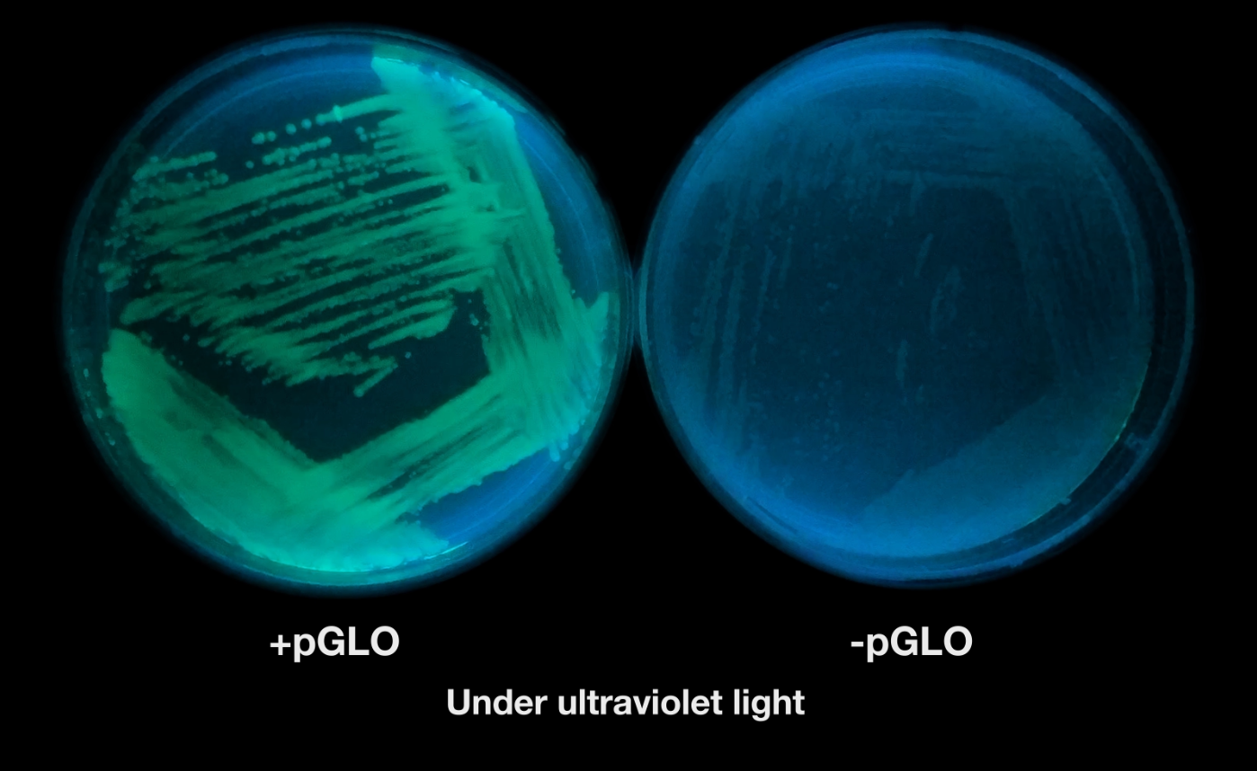
What did you notice?
www.bio-rad.com/glow
About the bacteria under the UV light?
About the difference between the +pGLO and –pGLO bacteria?
Notes:
Have students watch the short video of the 2 bacterial plates over 24 hr and ask them what they noticed. They may say things like:
They looked the same until the UV light came on
1 plate glowed and the other didn’t
One plate had more bacterial growth than the other

Slide 11
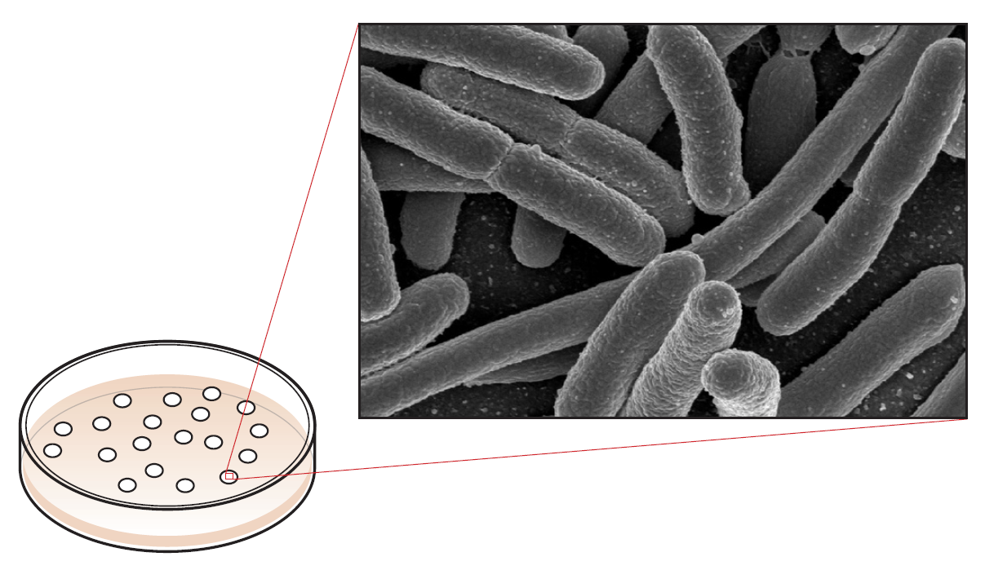
E. Coli colonies
The bacterial growth you see on the plate is made of millions of individual bacterial (E. coli) cells.
Notes:
Colonies have millions of cells that are all clones from one bacterium.

Slide 12
Aequorea victoria
Similarities and differences between these glowing jellyfish and bacteria?
How do you think jellyfish make green fluorescent protein (GFP)?
Visible light
UV light
Notes:
Students may have seen jellyfish under UV light and noticed their glow. The glow is caused by the Green Fluorescent Protein (GFP). The GFP gene was isolated from the Aequorea victoria jellyfish, and the three scientists who discovered and worked on GFP were awarded the Nobel Prize in Chemistry in 2008. Talk to students about how they think jellyfish make green fluorescent protein (there is a gene that encodes for it).

Slide 13
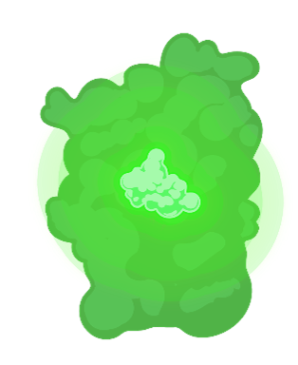
Green Fluorescent Protein (GFP)
GFP allows us to visualize protein expression with UV light
Notes:
The discovery of GFP has revolutionized cell biology. GFP can be fused to other proteins to enable scientists to localize proteins in living cells, tissues, organs, and organisms, something that had been impossible before the discovery of GFP.

Slide 14
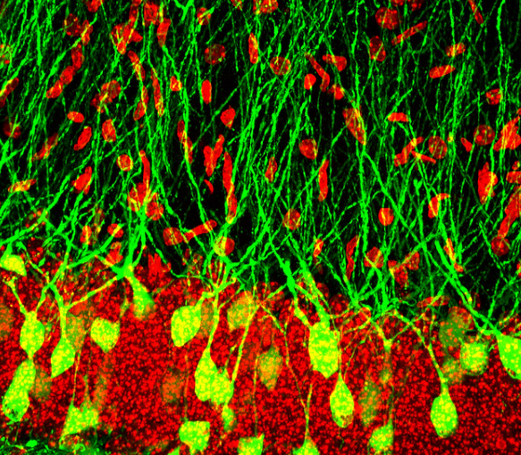
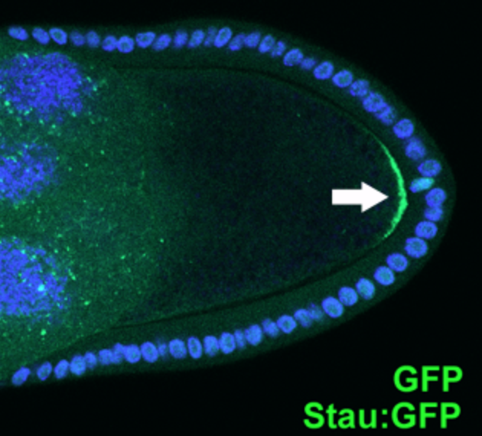
GFP as a visual tracer / marker
Study of biological processes (such as protein synthesis)
Localization and regulation of gene expression
Cell movement
Cell fate during development
Formation of different organs
Screenable marker to identify transgenic organisms
Cellular localization of drugs
Sparse granule cells | infected with HSV, expressing gfp | Jason Snyder | Flickr
Stauffen protein localization in Drosophila stage 9 oocytes

Slide 15
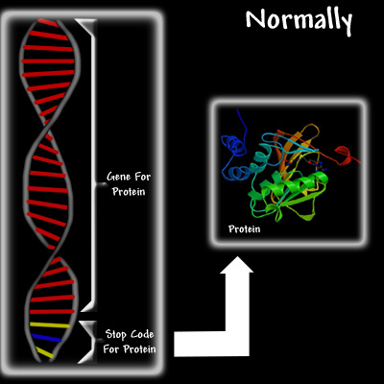
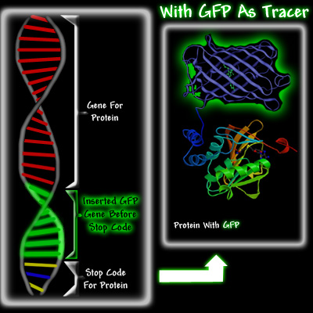
GFP as a visual tracer
http://www.conncoll.edu/ccacad/zimmer/GFP-ww/prasher.html
With permission from Marc Zimmer

Slide 16
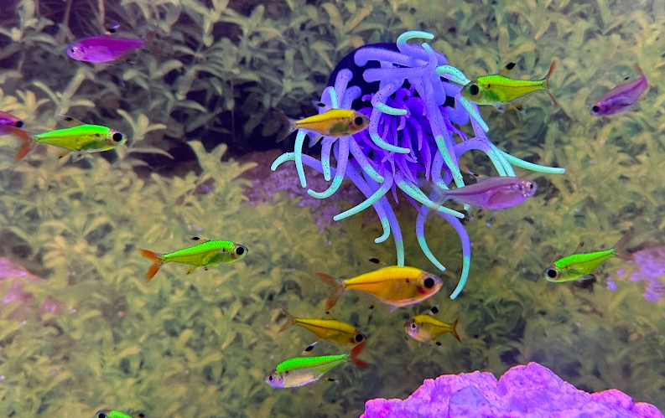
GFP (and other variants) animal – GloFish!

Slide 17
Genetic engineering / transformation
Research
Agriculture
Medicine
transgenic bacteria to produce DNA and proteins
corn, Hawaiian papaya, soybeans, cotton, sugar beets, canola, alfalfa
synthetic insulin, human growth hormones, vaccines, CAR-T
Notes:
Why are we learning about transformation? Genetic transformation is an essential technique to all of biotechnology. In research, scientists use transformation for producing proteins (like GFP in this lab) and for making large quantities of DNA. In agriculture, genes coding traits such as resistance to frost, pests, or drought can be genetically transformed into plants. In bioremediation, bacteria can be genetically transformed with genes enabling them to digest oil spills. In medicine, diseases caused by defective genes are beginning to be treated by gene therapy; that is, by genetically transforming a sick person’s cells with healthy copies of the defective gene that causes their disease. We make insulin and other drugs using genetically transformed bacteria, yeast, and mammalian cells. We’re even reprogramming human immune cells to attack cancer cells (CAR-T therapy).

Slide 18
Genetic engineering using plasmids
bacterium
chromosome
plasmids
Notes:
Many bacteria have small circular pieces of DNA in addition to their chromosomes. These pieces of DNA are called plasmids, and they often carry extra genes that confer some sort of selective advantage, such as a gene for antibiotic resistance.
Plasmids allow a gene to be moved from one organism and expressed in another. They can be engineered by scientists to carry specific genes. They can be used with bacterial, plant, and even mammalian cells. The gene that codes for human insulin was initially genetically engineered into a plasmid and expressed in bacteria in 1978 by scientists at Genentech. This was the first-ever recombinant protein developed for a pharmaceutical application.

Slide 19
Generic plasmid
ori
origin of replication allows bacteria to make copies of plasmid
pGeneric
gene
gene of interest cloned
into plasmid
Notes:
Here’s a diagram of a generic plasmid. To copy themselves in the cytosol, plasmids need a starting point for replication, called the origin of replication, or “ori”. The ori has recognition sites for DNA polymerases that replicate DNA and enable the plasmid to be cloned (copied) as the bacterium divides. Genes are represented as arrows. In this plasmid, a gene that a scientist is interested in has been cloned into the plasmid.

Slide 20
Cloning a gene
1
Isolate gene of interest and cut with restriction enzymes (or use PCR)
Cut plasmid with same restriction enzymes
2
3
Insert gene into plasmid using DNA ligase
Notes:
Cloning a gene makes an exact copy of the DNA sequence of the gene. (The term cloning is also used in cell biology when an exact copy of a cell is made.)
Historically, genes were cloned using restriction enzymes that break DNA at specific locations to cut out a target gene from the original organism. Now, PCR (polymerase chain reaction) is used to make copies of the gene directly from the genome of the original organism. The plasmid is then cut with restriction enzymes to open the circle of DNA. The gene of interest is then linked, or ligated, into the plasmid using ligase. During ligation, the sugar phosphate bonds are reformed between the base pairs and the plasmid again forms a circle of DNA.
Modern lab-generated plasmids are designed to make cloning as easy as possible. These plasmids have an area called a multiple cloning site (MCS), which is a string of unique restriction enzyme recognition sites. The MCS is used to open the plasmid so that it is ready to receive the gene of interest. Because there are many restriction sites in the MCS, it is likely that there will be a site that matches the sticky ends of the DNA fragment or the gene of interest.

Slide 21
Bacterial transformation
Genetic transformation occurs when a cell takes up DNA and expresses the genes on that DNA.
Many different types of cells can be transformed – plants, animals, human, bacteria.
Notes:
Different cell types often require different types of transformation procedures. This lab activity focuses on one method used in bacteria call heat shock transformation.

Slide 22
Bacteria divide and new bacteria get plasmids
Notes:
When bacteria divide during fission, each new bacterium gets a share of the plasmids. The number of plasmids per bacterial cell is referred to as the copy number and can vary from 5 to more than 1,000.
The ori determines the copy number of plasmids.
Plasmids that are present in relatively low numbers in the cells are referred to as low copy number plasmids, while plasmids that are present in much higher numbers are referred to as high copy number plasmids.

Slide 23
Genes get transcribed and translated
transcription
translation
protein
Notes:
Once the plasmid is inside the bacterium, the bacterial machinery transcribes and translates the genes on the plasmid (as well as the genes on the bacterial chromosome). This essentially turns bacteria into little protein factories, where they are producing the protein from the gene that was inserted into the plasmid.

Slide 24
Activity: Model recombinant GFP bacteria
Notes:
Student Activity: Students can move the images on the right around to put what they’ve learned together and create a model for recombinant bacteria expressing GFP, starting with a jellyfish. There is no “right” way this should look, but the activity will likely uncover some misconceptions that can be addressed. It may be helpful to create a “consensus” class model once each group has been given a chance to create their own.

Slide 25
Plasmid with gene for GFP
ori
origin of replication allows bacteria to make copies of plasmid
gfp gene
encodes Green Fluorescent Protein (GFP)

Slide 26
Selection of transformed bacteria
Notes:
Transformation efficiency is fairly low – during the process, only a small percentage of bacteria receive the plasmid. If we’re trying to get lots of protein (or lots of plasmid DNA) from our bacteria, we ONLY want to grow the ones that were transformed.

Slide 27
Selection of transformed bacteria
Notes:
We need some way to selectively grow the bacteria that got the plasmid.

Slide 28
Plasmids can carry multiple genes
Notes:
This is a plasmid with an ori and 3 genes. Arrows that go in different directions indicate genes that are coded for on the other strand of DNA.

Slide 29
β-lactamase gene for antibiotic resistance
ori
origin of replication allows bacteria to make copies of plasmid
amp^{r} (or bla) gene
encodes beta-lactamase,
an enzyme that breaks down
ampicillin (an antibiotic)
gfp gene
encodes Green Fluorescent Protein (GFP)
Notes:
This plasmid has the gfp gene as well as the gene for beta-lactamase, which provides resistance to the antibiotic ampicillin, a member of the penicillin family. The beta-lactamase protein is produced and secreted by bacteria that contain the plasmid. Beta-lactamase inactivates ampicillin present in the LB nutrient agar, allowing bacteria to grow.
At the concentrations used in this lab, beta-lactamase is bacteriostatic – meaning it prevents bacterial growth, but it doesn’t kill the bacteria (bactericidal).

Slide 30
Transformation with plasmid with amp^{r}
Notes:
Let’s take a look at what happens when we transform bacteria with this plasmid. The plasmid gets into this one bacterium.

Slide 31
β-lactamase produced
Notes:
Beta-lactamase gene is transcribed and translated.

Slide 32
Bacteria plated on ampicillin plates
Notes:
These bacteria are plated on LB/amp agar plates that contain ampicillin.

Slide 33
β-lactamase breaks down ampicillin
Notes:
The bacteria that have been transformed have beta-lactamase, which will start breaking down the ampicillin in the plate.

Slide 34
Bacteria that aren’t transformed don’t grow
Notes:
Untransformed cells cannot grow on the ampicillin selection plates.

Slide 35
Transformed bacteria grow into colonies
Notes:
The transformed bacteria are the only ones that can divide and grow into colonies. We’ve just used ampicillin to select for bacteria that were transformed with our plasmid.

Slide 36
pGLO plasmid (simplified)
ori
origin of replication allows bacteria to make copies of plasmid
pGLO
amp^{r} (or bla) gene
encodes beta-lactamase,
an enzyme that breaks down
ampicillin (an antibiotic)
gfp gene
encodes Green Fluorescent Protein (GFP)
Notes:
Here’s a look at a simplified version of the pGLO plasmid. Instructors – please note that the araC gene and pBAD promoter are not mentioned or shown here. The idea is to introduce the control of gene expression later on. For now, we just want to focus on the big picture of bacterial transformation and selection. At this point, students will assume that if genes are on a plasmid, they will be expressed (constitutively). That’s perfectly fine and expected!

Slide 37
pGLO plasmid (simplified)
pGLO
gfp
amp^{r}
Notes:
Here’s that same simplified plasmid – they’ll see this in the next modeling activity, which comes after the transformation protocol.

Slide 38
Student Lab Protocol – Day 1
Bacterial transformation with pGLO plasmid

Slide 39
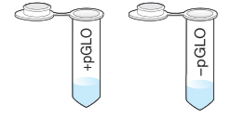
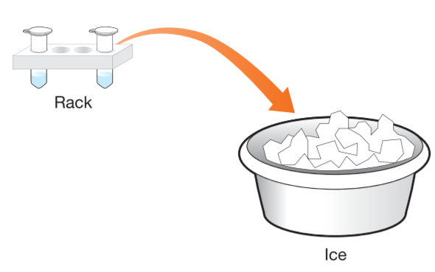
Lab protocol - transformation
1.
You have 2 tubes with 250 μl of transformation solution. Label the top of one tube + pGLO and the other – pGLO . Add your group ID or initials to each tube.
2.
Put both tubes on ice.
Notes:
Note: Labels are shown on the sides of tubes for clarity. Students should label the tops of the tubes.

Slide 40
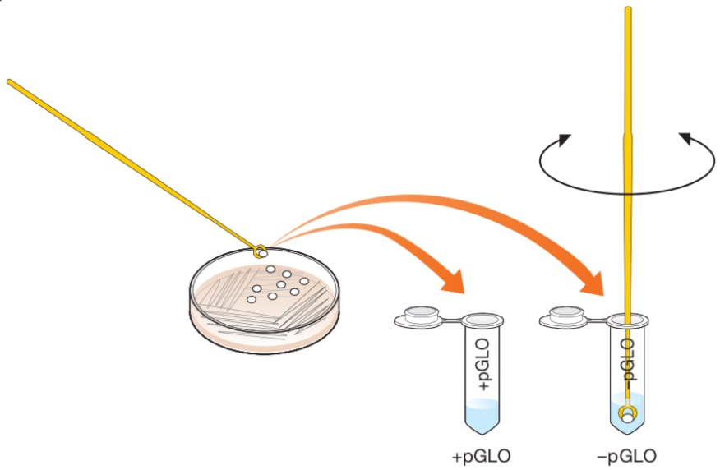
Lab protocol - transformation
3.
Use a sterile loop to scrape 2-4 single E. coli colonies from the surface of the starter plate. Transfer the loop into the + pGLO tube and swirl it in the transformation solution to disperse the bacteria. Close the tube and place it back on ice.
4.
Use a new loop and repeat step 3 to transfer bacteria to the – pGLO tube.
Notes:
Note: students should swirl loop for at least 30 seconds. If you have a vortexer, they can use that to break up any clumps. Alternatively, they can quickly drag the tube back and forth across a plastic rack to mix contents.

Slide 41
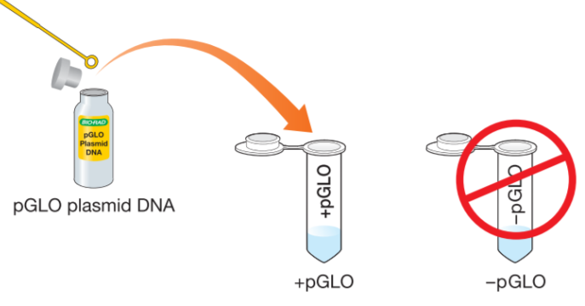
Lab protocol - transformation
5.
Dip a loop into the pGLO plasmid vial, check for a film across the circle, and swirl the plasmid in the +pGLO tube. Do not add any plasmid into the –pGLO tube.
6.
Incubate the tubes on ice for 10 minutes. Make sure the tubes are in full contact with the ice.
Notes:
Note: if you have a pipet, you can use it to transfer 10 μl of plasmid into the + tubes.

Slide 42
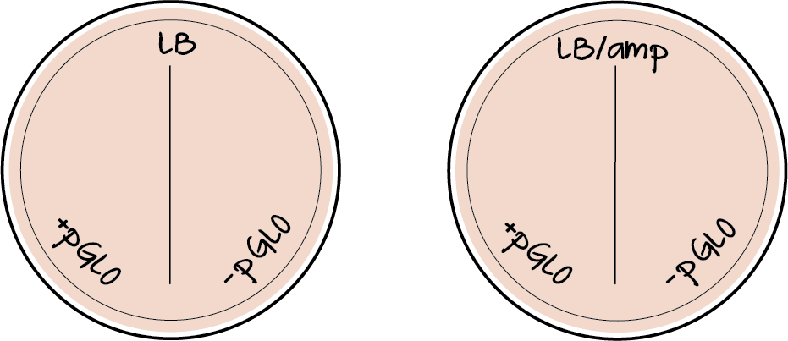
Lab protocol - transformation
7.
Label plates as shown here:
Draw a line down the center of each plate
Write + pGLO on one side of each plate, and – pGLO on the other.
Note: Plates should be labeled on the bottom (agar side) around the edge, in small, neat writing, so the bacteria colonies can be easily seen.

Slide 43
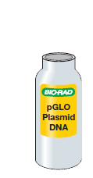
Look at the plasmid under UV light
What color is the DNA?
Can you see any green?
Notes:
This helps students understand that the DNA isn’t green and they aren’t adding anything green to the bacteria. The DNA is colorless and only provides the instructions to make GFP.

Slide 44
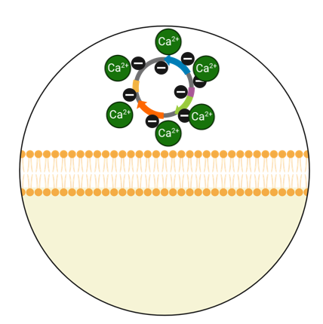
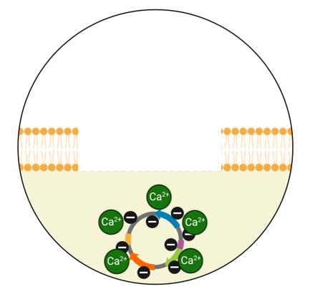
Background Information
Bacterial transformation steps
Notes:
Note to instructor: these slides are nice to discuss in the downtime during the ice incubation step, but you may choose to move them up and talk about them before the procedure begins.

Slide 45
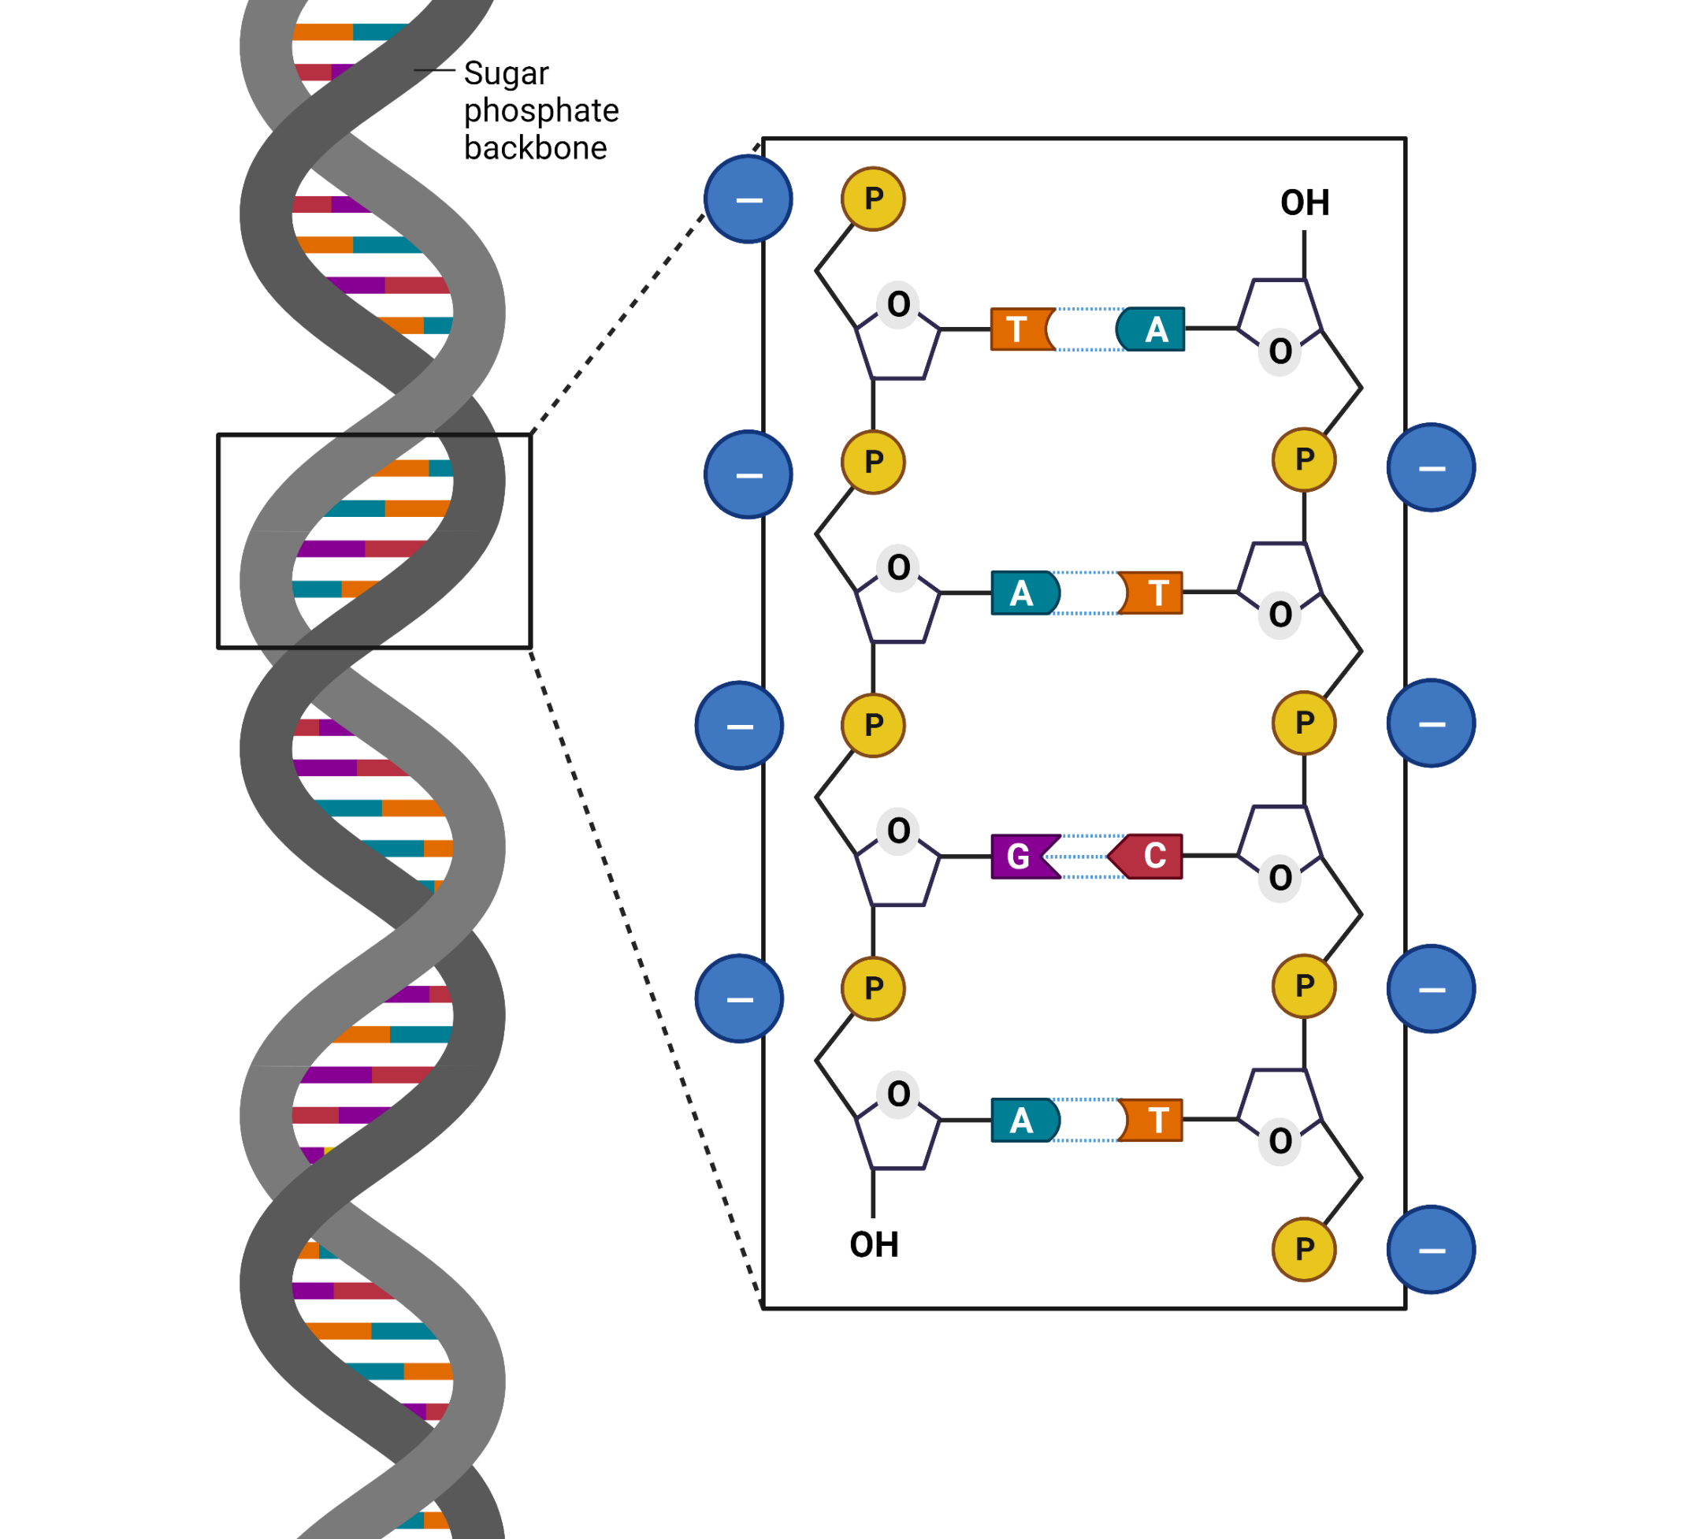
DNA is negatively charged
Notes:
DNA has a phosphate backbone that is negatively charged.

Slide 46
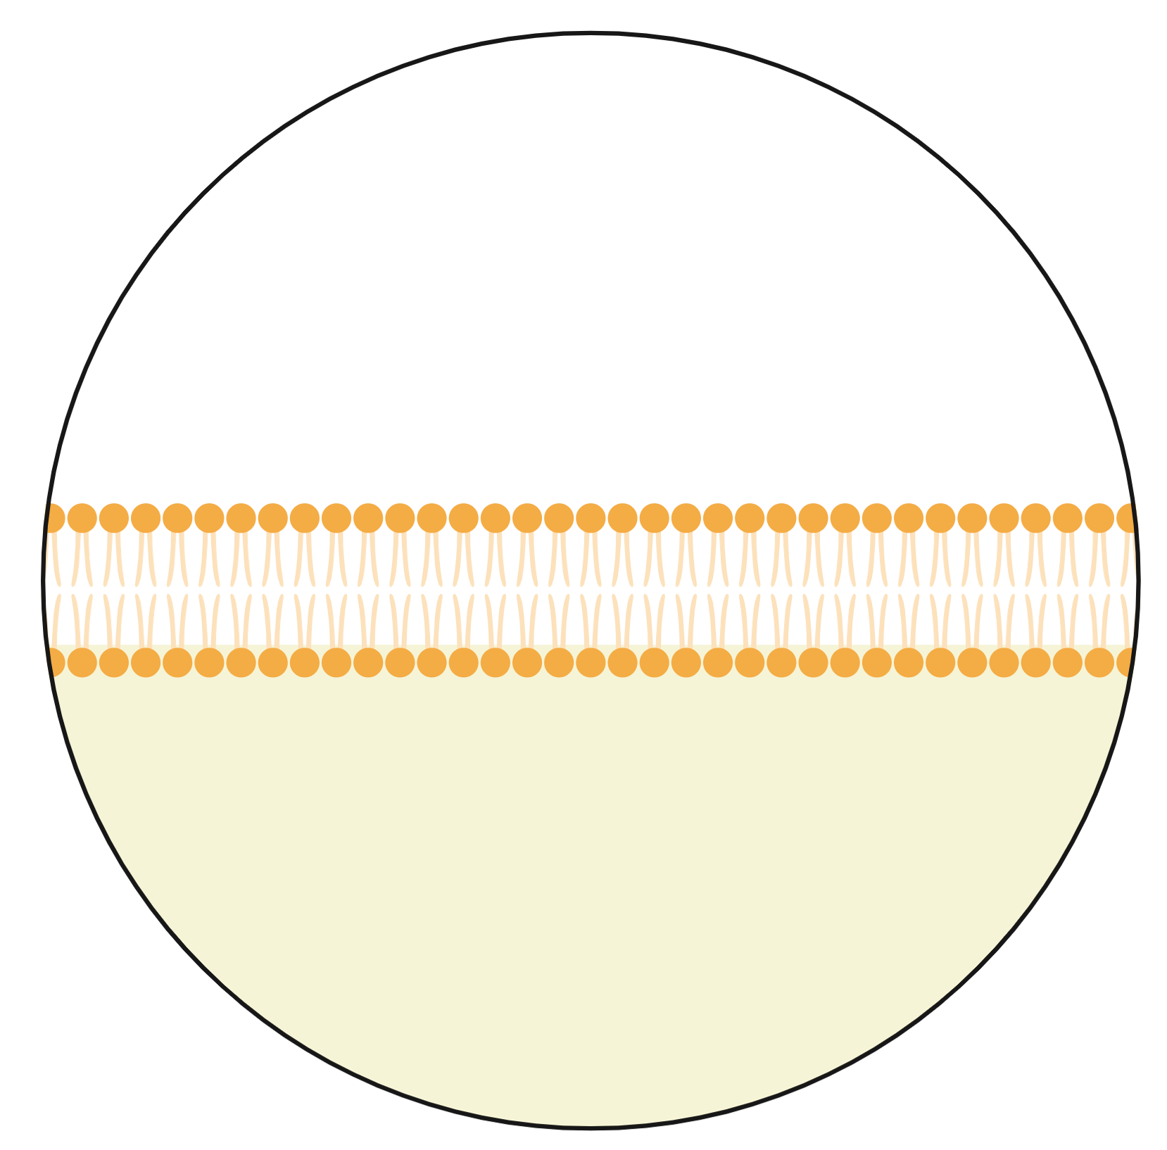
CaCl₂ transformation solution
negative charges
plasmid
plasma
membrane

Slide 47
CaCl₂ transformation solution
Ca²⁺ shields
negative charges
Notes:
Ca2+ cations of the transformation solution (50 mM CaCl2, pH 6.1) neutralize the repulsive negative charges of the phosphate backbone of the DNA and the phospholipids of the cell membrane to allow the DNA to enter the cells.

Slide 48
Incubate on ice for 10 min
Ca²⁺ shields
negative charges

Slide 49
Heat shock at 60°C for 50 sec
Pores form in membrane
Notes:
You can also do

Slide 50
Incubate on ice for 2 min

Slide 51
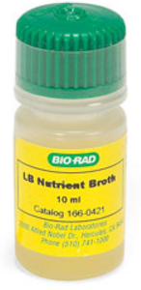
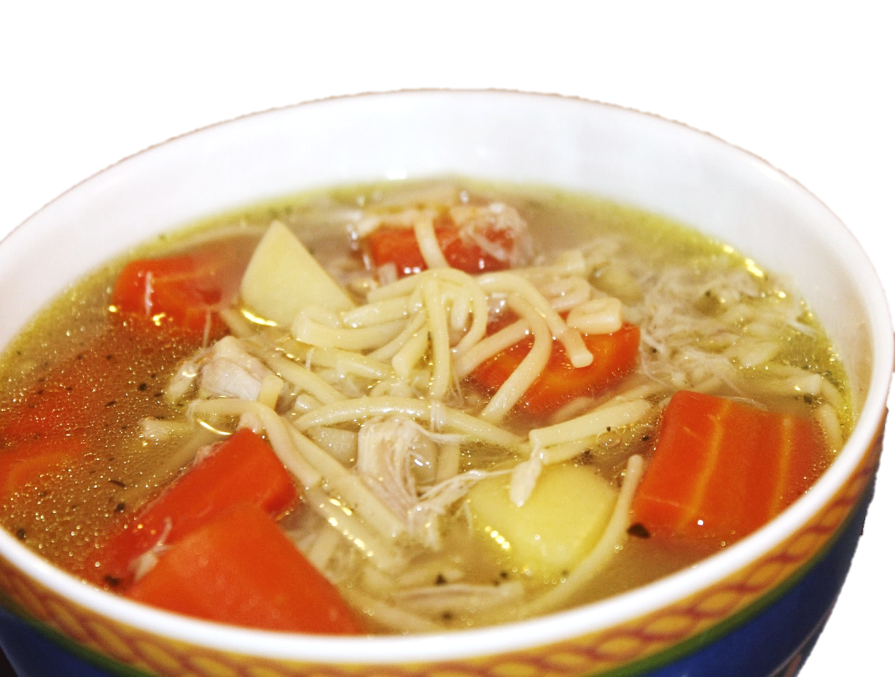
LB broth
LB (lysogeny broth or Luria Bertani) broth is like chicken noodle soup for bacteria. It has all the nutrients bacteria need to grow:
Carbohydrates
Amino acids
Nucleotides
Salts
Vitamins

Slide 52
LB recovery
During recovery, E. coli repair their cell walls and express the antibiotic resistance gene so they can grow on ampicillin plates.
Notes:
The 10-min incubation period following the addition of LB nutrient broth allows the cells to recover and to express the ampicillin resistance protein beta-lactamase so that the transformed cells survive on the ampicillin selection plates. The recovery culture can be incubated at room temperature or at 37°C for 1 hr to overnight. This can increase the transformation efficiency by more than 10-fold.
The full plasmid is shown here – feel free to swap it out for the simplified version if you’d like (with only amp-r and gfp genes).

Slide 53
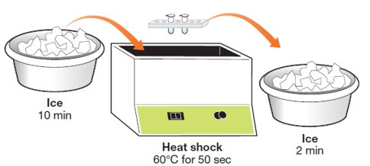
Lab protocol - transformation
8.
Heat shock: get your timers ready! Transfer the tubes directly from the ice into a 60°C water bath or dry bath for exactly 50 sec, then immediately place them back on ice.
9.
Incubate tubes on ice for 2 min.
Note: Heat shock should be QUICK! Straight from ice, into heat, back to ice.
Notes:
For best results, students should transfer their tubes straight from the ice into the water/dry bath and back onto ice.
Note: this heat shock temperature was found to have greater transformation efficiency than 42°C.

Slide 54
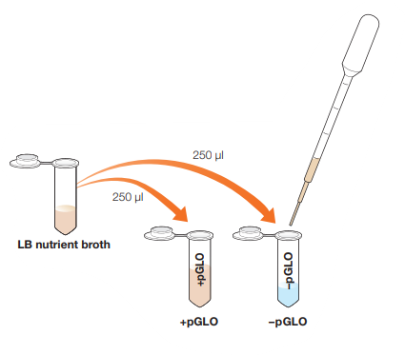
Lab protocol - transformation
10.
Remove the tubes from ice and pipet 250 μl of LB broth into each tube. Incubate at room temperature for at least 10 min.
Note: Bacteria can be left at room temperature overnight before proceeding to the next step.
Notes:
Bacteria can also be put in the incubator during this recovery time.
If needed, students can leave their bacteria at room temp overnight and plate the next day.

Slide 55
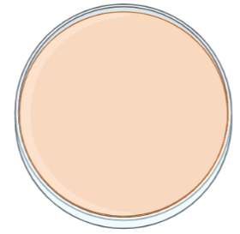
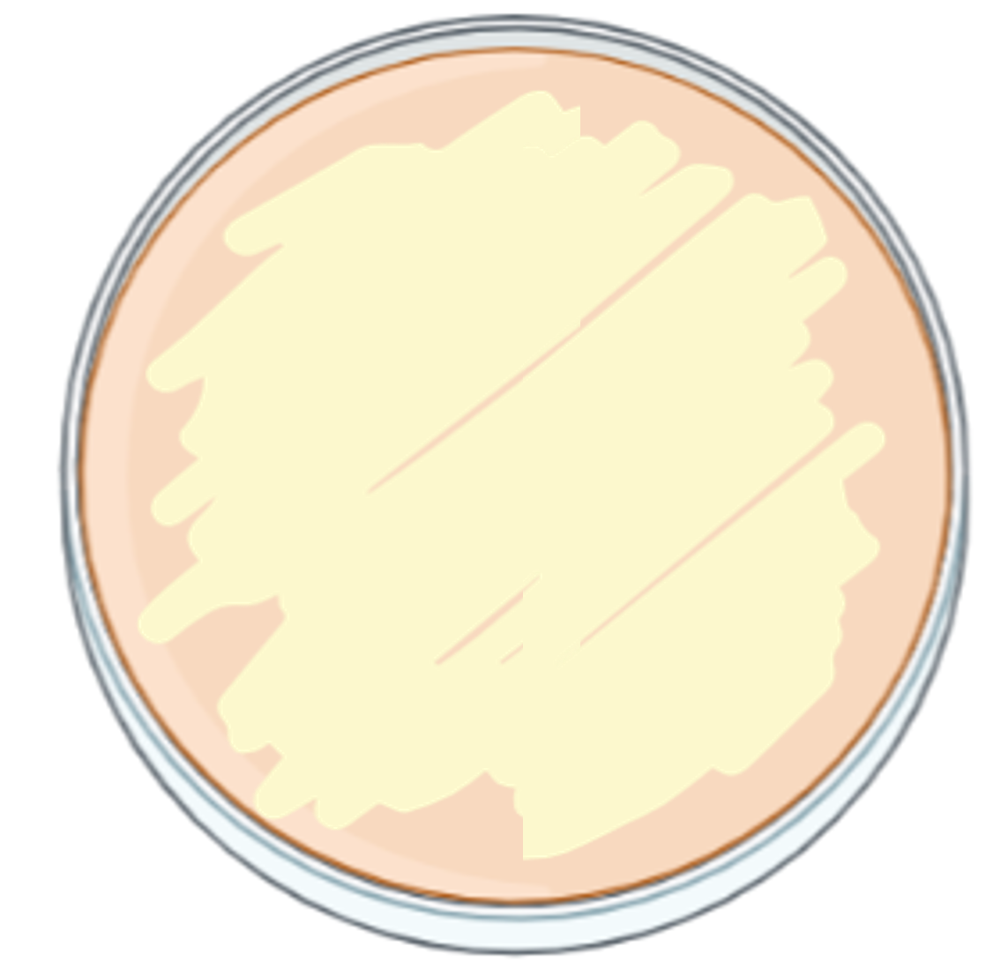
Activity: Predict transformation results
Colonies
Lawn
Bacteria typically grow in colonies that arise from 1 bacteria dividing over and over.
All the individual colonies have merged to form a uniform layer of bacterial growth.
Notes:
Before students make their predictions, make sure they understand the difference between colonies and lawns. Bacteria normally grow in colonies. Lawns will grow when the concentration of bacteria is much higher – the colonies all merge together to form a dense layer of growth.

Slide 56
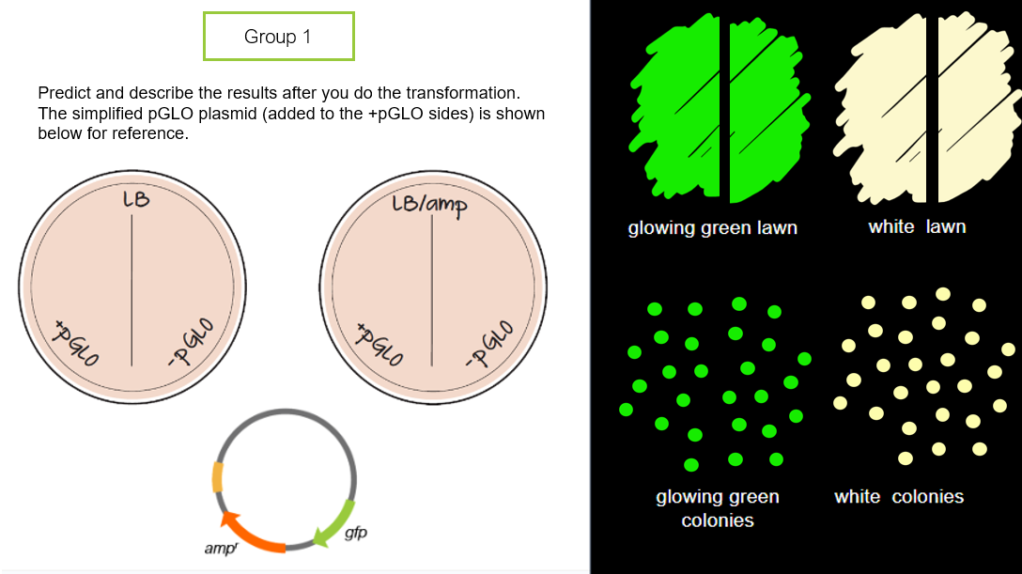
Activity: Predict transformation results
Notes:
(Click on image link to go to modeling slide)
Student Activity: During the recovery period, students can make predictions based on what they know so far. They can drag and drop green or white lawns or colonies to the plates. They may need to make copies. Again, there is no “right” answer, but you should be able to uncover some misconceptions, especially about transformation efficiency (colonies vs. lawns) and antibiotic selection. Remember, they haven’t yet learned about gene regulation, so they will most likely assume that the amp-r and gfp genes are expressed.

Slide 57
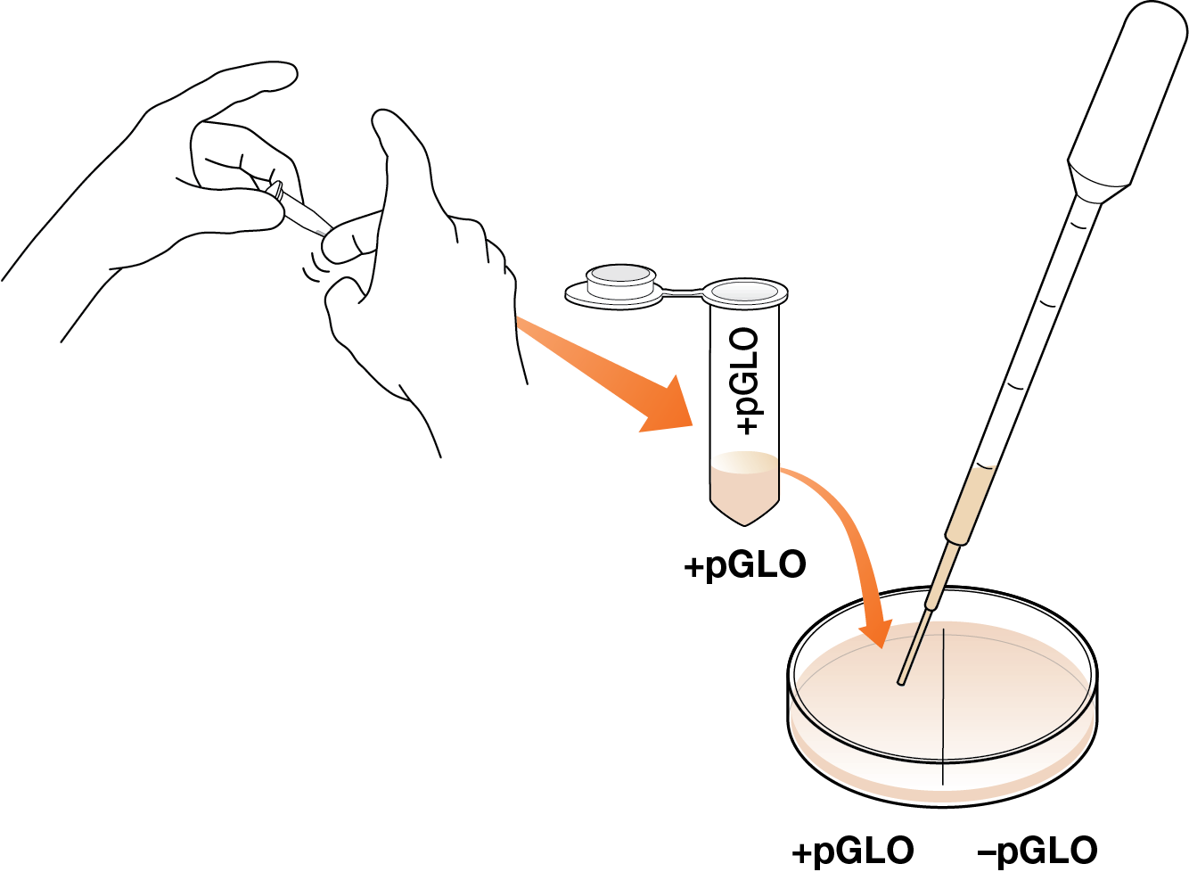
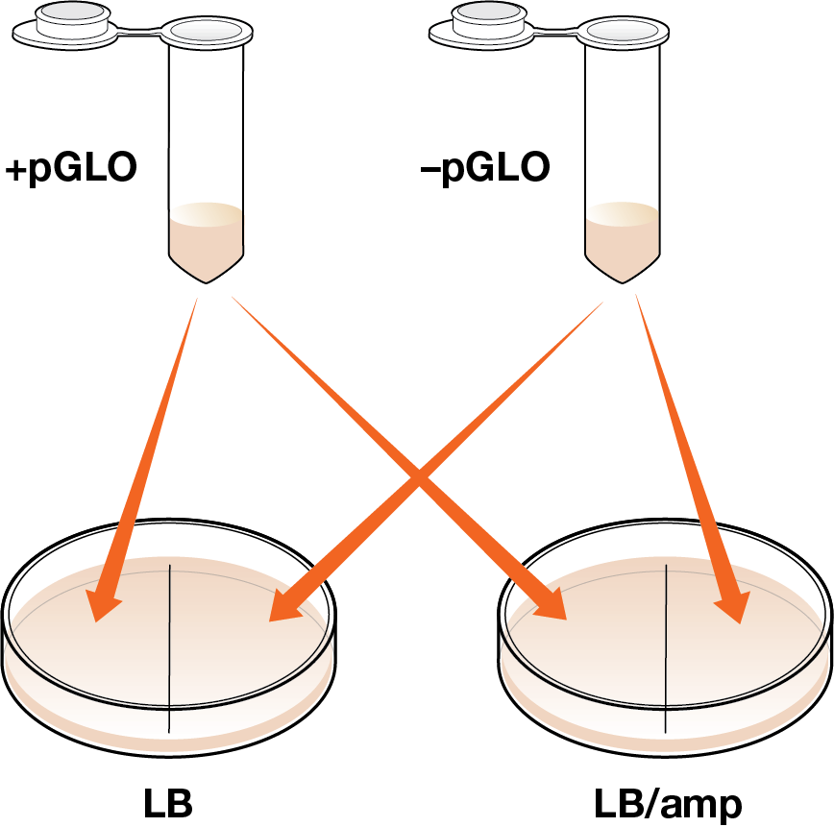
Lab protocol - transformation
11.
Flick tubes to mix. Pipet one drop from each tube onto the appropriately half of each plate. Use a new pipet for each tube.

Slide 58
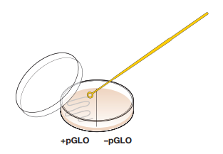
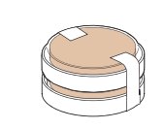
Lab protocol - transformation
12.
Use a new loop to spread the bacteria on each half of each plate. Use a fresh loop each time.
13.
Stack plates upside down (agar side up) and incubate overnight at 37°C or at room temperature for 2 days.

Slide 59
Results & Analysis
After Day 1

Slide 60
Results after day 1
Notes:
When students check their plates the next day, they’ll see white lawns on the LB plate and white colonies on the +pGLO side of LB/amp plate – but nothing will glow! Why is that?

Slide 61
Results after day 1
Do you think the gene for GFP was successfully transformed into any bacteria? Explain your reasoning.

Slide 62
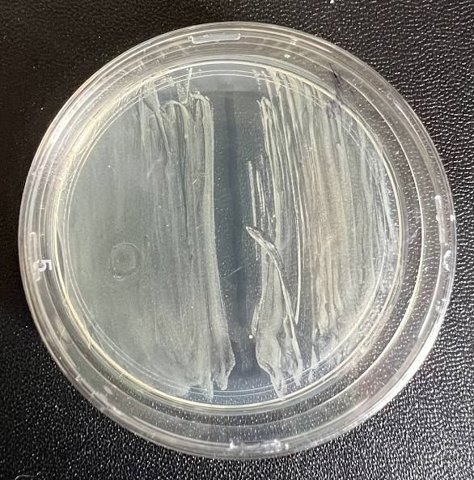
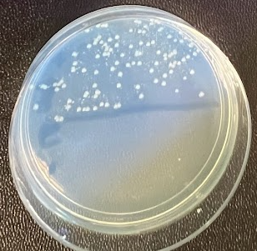
Results after day 1 under regular light
-
-
+
+
LB
LB/amp

Slide 63
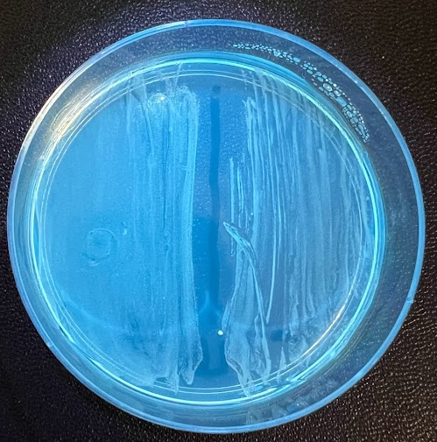
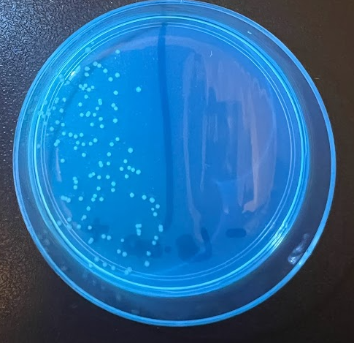
Results after day 1 under UV – no glow!
-
-
+
+
LB
LB/amp
Notes:
No glowing bacteria!

Slide 64
Background Information
Control of gene expression with arabinose operon

Slide 65
pGLO plasmid – regulation of GFP expression
araC gene
encodes the
AraC repressor protein
ori
origin of replication allows bacteria to make copies of plasmid
pGLO
pBAD promoter
landing site for RNA polymerase
to transcribe downstream genes
amp^{r} (or bla) gene
encodes beta-lactamase,
an enzyme that breaks down
ampicillin (an antibiotic)
gfp gene
encodes Green Fluorescent Protein (GFP)

Slide 66
Without arabinose in the media
OFF
Notes:
Without arabinose, the expression of GFP is turned off. See next slides for a more in-depth explanation of the arabinose operon.

Slide 67
With arabinose in the media
ON
Notes:
Arabinose is a sugar that acts like a chemical switch. When it’s present in the media, it will switch on the expression of GFP.

Slide 68
Arabinose and AraC
Arabinose
(inducer)
AraC acts as a repressor in the absence of arabinose
When arabinose binds AraC, the AraC conformation changes, activating the expression of the araBAD genes that metabolize arabinose
Notes:
Transcribing and translating genes takes up energy; therefore, only necessary proteins are expressed by cells at any one time. This means that cells must regulate when and to what level they transcribe their genes.
Some genes need to be expressed all the time, while others need to be expressed only at certain times or in certain environments.
Genes that are always expressed are referred to as constitutive genes, while genes that are transcribed only when needed are referred to as facultative genes.
Operons are controlled by repressor proteins that are encoded by an additional gene. Repressor proteins bind to the operator region near the operon and block RNA polymerase from transcribing. To turn the operon on, the sugar (lactose or arabinose, depending on the type of operon) binds to the repressor and relieves the block, thereby allowing transcription. The sugar is called an inducer.

Slide 69
Arabinose operon (araBAD operon)
RNA polymerase
OFF
AraC
Without arabinose, AraC acts as a repressor – a loop is formed in the DNA, preventing RNA polymerase from transcribing araBAD genes
Notes:
Bacteria regulate expression of some of their facultative genes using operons.
Operons are naturally occurring control units in bacterial chromosomal DNA that consist of one promoter, multiple genes, and a single terminator.
The araBAD operon controls the production of enzymes involved in the metabolism of arabinose, a sugar.
Operons are controlled by repressor proteins that are encoded by an additional gene. Repressor proteins bind to the operator region near the operon and block RNA polymerase from transcribing.
To turn the operon on, the sugar (lactose or arabinose, depending on the type of operon) binds to the repressor and relieves the block, thereby allowing transcription.
The sugar is called an inducer. Inducible operons can turn on genes that are normally off, while repressible operons can turn off genes that are normally on.

Slide 70
Arabinose operon (araBAD operon)
With arabinose, AraC undergoes a conformational change, allowing RNA pol to transcribe the araBAD genes
ON
arabinose
RNA polymerase
Notes:
Three genes (araB, araA and araD) encode three enzymes involved in the breakdown of arabinose. They’re clustered together in what is known as the L-arabinose operon.
These three proteins are dependent on initiation of transcription from a single promoter, PBAD. Transcription of these three genes requires the simultaneous presence of the DNA template (promoter and operon), RNA polymerase, a DNA binding protein called araC and arabinose.
araC binds to the DNA at the binding site for the RNA polymerase (the beginning of the arabinose operon). When arabinose is present in the environment, bacteria take it up. Once inside, the arabinose interacts directly with araC which is bound to the DNA. The interaction causes araC to change its shape which in turn promotes the binding of RNA polymerase, and araB, A and D, are transcribed. Three enzymes are produced, they break down arabinose.

Slide 71
Once arabinose is metabolized, switch is off
RNA polymerase
OFF
AraC
Without arabinose, AraC acts as a repressor – a loop is formed in the DNA, preventing RNA polymerase from transcribing araBAD genes
Notes:
Eventually, the arabinose runs out. The bacterium doesn’t want to waste any energy making more enzymes, so in the absence of arabinose, the araC returns to its original shape and transcription is shut off.

Slide 72
Control of GFP expression - pGLO plasmid
RNA polymerase
OFF
AraC
Without arabinose, RNA polymerase is blocked from transcribing the GFP gene.
Notes:
The pGLO plasmid has been designed to express green fluorescent protein (GFP), under the control of the arabinose operon (araBAD).
Scientists took inducible operons from bacterial chromosomal DNA and genetically engineered them into plasmids.
In the case of the pGLO plasmid, a team of scientists made a plasmid called pBAD18 by cloning the araBAD promoter and the gene for the AraC repressor protein into a parental plasmid containing an ori and the antibiotic-resistant bla gene.
Another team cloned the green fluorescent protein (GFP) gene from the jellyfish Aequorea victoria into a different plasmid.
A third group of scientists then used restriction enzymes to clone the GFP gene into the pBAD18 plasmid downstream of the araBAD promoter. As a result, the araBAD operon and the AraC protein regulate the expression of GFP. Using this system GFP is expressed only in the presence of arabinose.

Slide 73
Control of GFP expression - pGLO plasmid
With arabinose, RNA polymerase can transcribe the GFP gene
ON
arabinose
RNA polymerase
Notes:
When arabinose is in the media, AraC changes confirmation, the DNA loop is released, and RNA pol can transcribe the gene for GFP.

Slide 74
pGLO plasmid
araC gene
encodes the AraC
repressor protein
ori
origin of replication allows bacteria to make copies of plasmid
pGLO
pBAD promoter
landing site for RNA polymerase
to transcribe downstream genes
amp^{r} (or bla) gene
encodes beta-lactamase,
an enzyme that breaks down
ampicillin (an antibiotic)
gfp gene
encodes Green Fluorescent Protein (GFP)

Slide 75
How do we produce drugs like insulin?
1
Clone human insulin gene into plasmid
2
Transform bacteria with plasmid
3
Select transformed
bacteria
4
Culture bacteria and
induce gene expression
5
Lyse cells
6
Purify protein with
chromatography
7
Analyze purification
with SDS-PAGE
8
Assay protein activity
Notes:
So why would scientists want the ability to switch genes on or off? Would we want the bacteria just expressing proteins all the time? In the case of biomanufacturing drugs like insulin, the bacteria are typically cultured first (grown in large quantities), and then the expression of the protein is induced. Allowing the bacteria to grow without the added energy expenditure of protein expression means that more bacteria can grow, creating more protein once the switch is switched on (the inducer is added).

Slide 76
Control of gene expression
Notes:
(Animated slide) – if bacteria are cranking out the protein as they grow, their growth will be inhibited, and less protein will be produced.

Slide 77
Control of gene expression
Notes:
(Animated slide) If you let the bacterial culture grow and THEN induce, you get more protein

Slide 78
Student Lab Protocol – Day 2
Expression of GFP

Slide 79
Design experiment to induce GFP expression
Notes:
Students can design an experiment to turn on the expression of GFP. They can decide where to add the liquid arabinose. They might choose to add it just on the +pGLO sides of their plates, or on the –pGLO sides as well as a control.

Slide 80
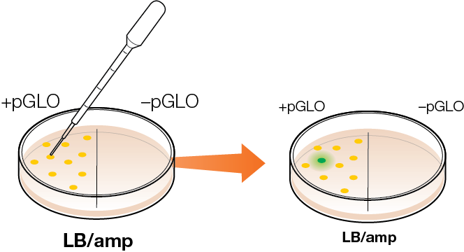
Design experiment to induce GFP expression
Notes:
The colonies on the +pGLO side of the LB/amp plate will glow green. If they use a micropipet and add 5-10 μl of arabinose to a colony they can turn on GFP expression in a more limited area. If they use a full drop from a disposable pipet, about 1/3 to ½ of the colonies on that side will express GFP.

Slide 81
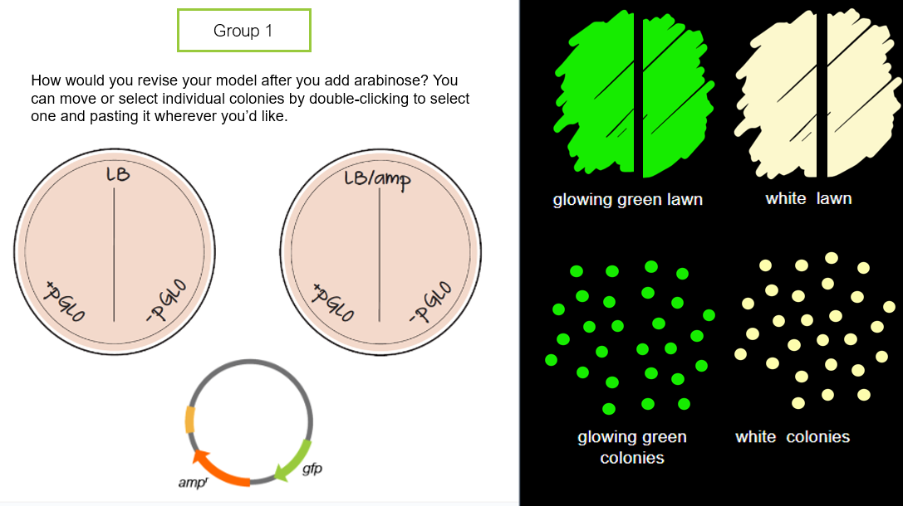
Activity: Predict results after Day 2
Notes:
Students can go back and revise their model to reflect what happens with and without arabinose.

Slide 82
Results & Analysis
After Day 2

Slide 83
Results after Day 2
Why do some bacteria glow green and others do not?
Write a claim about how arabinose influenced the expression of GFP.
Revise your model.
Notes:
Note – students will not see only 1 glowing green colony unless they use a micropipet and add about 5μl of liquid arabinose just to that colony. Otherwise, the arabinose will diffuse out and about 1/3 of the +pGLO colonies will turn green. The expression of GFP becomes visible in about 3 hours.

Slide 84
Results after adding arabinose – UV
-
-
+
+
LB
LB/amp
Notes:
The LB plate has a lawn of non-transformed bacteria on each side, as well as several transformed colonies on the + side (glowing green).
The LB/amp plate has glowing green colonies on the + side, and no growth on the – side.
You may also see some smaller white colonies on the + side, especially after a day or 2. Ask your students what they think is happening (see next slide for details).

Slide 85
Small white colonies around green colonies?
-
+
LB/amp
Notes:
These are satellite colonies that pop up after the transformed bacteria (glowing green) have made and secreted beta-lactamase into the plate. The ampicillin is broken down in the plate around the transformed colonies, giving non-transformed bacteria the opportunity to grow. The satellite colonies are not transformed, and if you streak them onto LB/amp plates they will not be able to grow.

Slide 86
β-lactamase diffused across plate to - side
Notes:
Given enough time, beta-lactamase will diffuse across the plate to the –pGLO side, allowing non-transformed bacteria to grow there as well.

Slide 87
Model Recombinant GFP Bacteria
Day before transformation lab

Slide 88
Group 1
E. coli
E. coli expressing GFP
Use these images to design a model for how scientists made recombinant GFP bacteria. You can resize, copy and paste, recolor, or create your own elements. Include a written description of what is happening in your model by typing over these instructions.
GFP protein
RNA
DNA
gfp
gene
plasmid

Slide 89
Predict Transformation Results
On Day 1

Slide 90
Group 1
Predict and describe the results after you do the transformation. The simplified pGLO plasmid (added to the +pGLO sides) is shown below for reference.

Slide 91
Predict Transformation Results
After Day 2

Slide 92
Group 1
How would you revise your model after you add arabinose? You can move or select individual colonies by double-clicking to select one and pasting it wherever you’d like.

Slide 93
Resources

Slide 94
pGLO Resource Webpage
www.bio-rad.com/teachpglo

Slide 95
Manuals
bio-rad.com/pglogenbiokit
Notes:
The pGLO Bacterial Transformation Kit for General Biology Kit ships with a printed answer guide. You can download the student and instructor guides from the website, or you can fill in the form at the QR code to receive copies by email, along with other resources.

Slide 96
pGLO Transformation Kit for General Biology 17006991EDU
12 workstations
2 lab activities
3-5 lab periods

Slide 97
www.bio-rad.com/classroomresources

